Slide 1

Mobile Application Development, Fall 2021 Our First Complete App Parts 1 & 2

Slide 2
Today’s Agenda
Today’s Plan
Creating a New React Native Project
Getting Started With Yelp
Getting Navigation Set Up
Actually Building the App!
Or at least getting the search bar set up!

Slide 3
Today’s Plan
So! At this point, we’ve gotten a lot of practice using the fundamental systems of react native in a bunch of tiny apps!
These apps have been great for educational purposes!
But their practicality in the “real world” is somewhat limited…

Slide 4
Today’s Plan
Today, we’re going to begin the process of making what probably feels closer to a “real” app!
Using all those same fundamentals that we’ve already been working with!

Slide 5
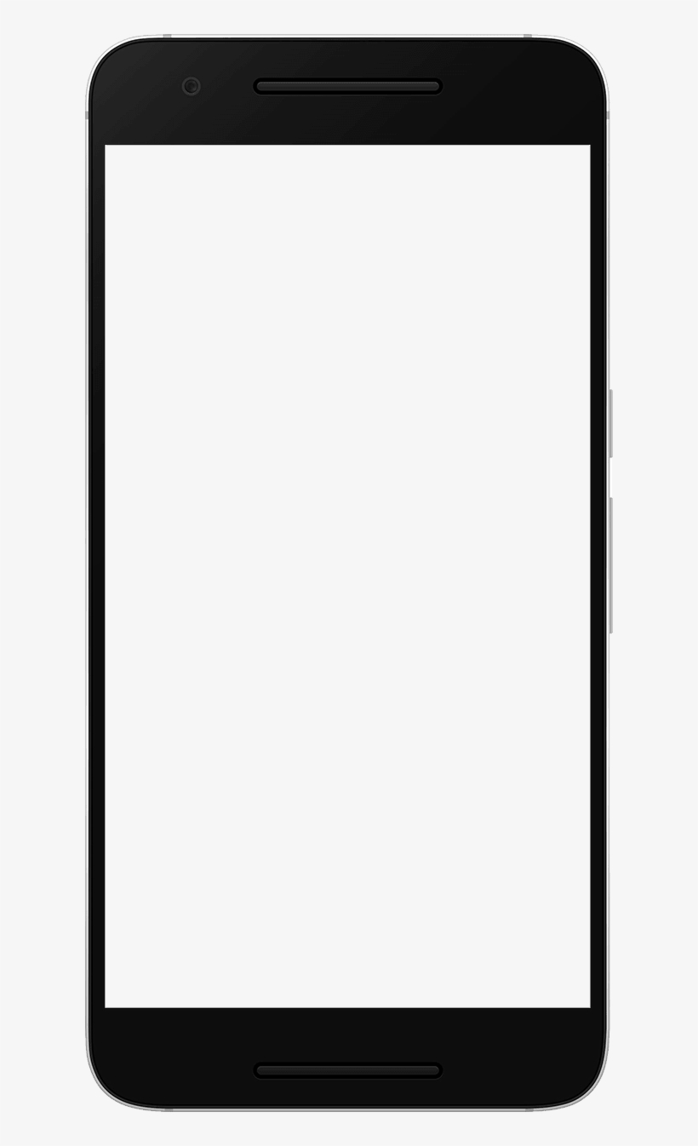
Today’s Plan
$ Restaurants
We’re going to make a “restaurant search app”
Using real life data from Yelp!
It will display data from different restaurants!
Categorizing “like” restaurants together.
Restaurant
Restaurant
$$ Restaurants
Restaurant
Restaurant
$$$ Restaurants
Restaurant
Restaurant

Slide 6
Today’s Plan
Specific Restaurant
$ Restaurants
And then when you click on a restaurant, it will show you specific details about that restaurant!
Restaurant
Restaurant
Picture
$$ Restaurants
Picture
Restaurant
Restaurant
$$$ Restaurants
Picture
Restaurant
Restaurant

Slide 7
Today’s Plan
Search Bar!
$ Restaurants
We’ll also incorporate a search bar!
This will help the user find a specific restaurant they have in mind.
Restaurant
Restaurant
$$ Restaurants
Restaurant
Restaurant
$$$ Restaurants
Restaurant
Restaurant

Slide 8
Today’s Plan
But before we start doing that… we’re going to do something that we’ve managed to avoid doing for a long time…
We’re going to make a *new* react native application from scratch.
As opposed to continuing to build off of rn-starter.
In theory, given everything else you’ve set up, it shouldn’t be that bad…

Slide 9
Today’s Agenda
Today’s Plan
Creating a New React Native Project
Getting Started With Yelp
Getting Navigation Set Up
Actually Building the App!
Or at least getting the search bar set up!

Slide 10
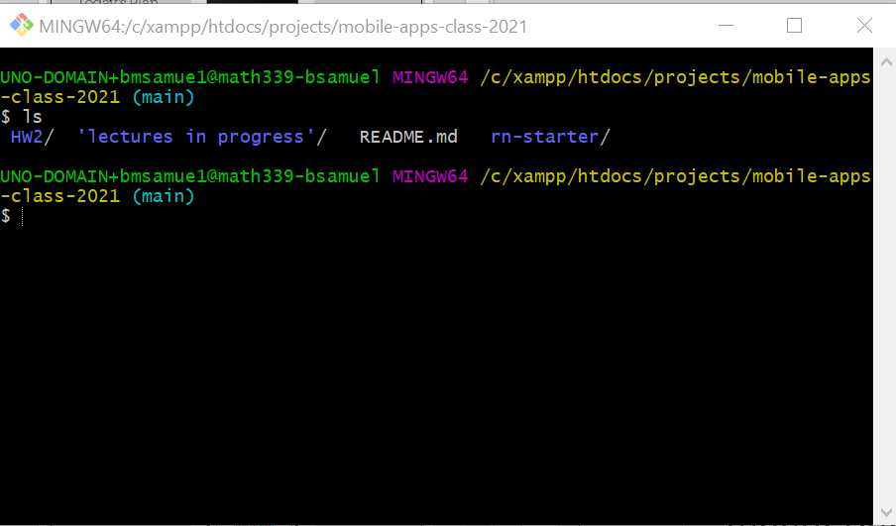
Creating a New React Native Project
But this is always my least favorite part of programming, as it seems like there is a higher density of arcane error messages than usual.
But let’s have a positive attitude, right?
First, navigate to wherever you saved rn-starter using a terminal.
Sadly: Git Bash is actually going to cause some problems with this! So just use your normal cmd terminal, or PowerShell instead!

Slide 11
Creating a New React Native Project
So for me, that’s inside of this mobile-apps-class-2021 directory.
The (main) you see is because I made it a git repo, and I’m just doing all my editing on the main branch, like a barbarian.
You can see that rn-starter is a subdirectory here.

Slide 12
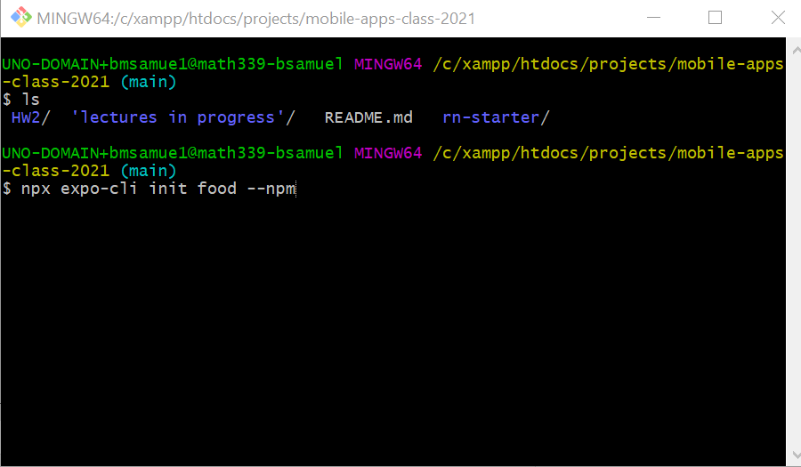
Creating a New React Native Project
Cross your fingers, and type the following onto the command line:
npx expo-cli init food --npm

Slide 13
Creating a New React Native Project
What does this line mean?
npx expo-cli init food --npm
npx is a node package *runner* -- as opposed to npm, which is a node package manager.
You should have gotten it “for free” when you installed node back in the day.
You can use it to execute node packages.

Slide 14
Creating a New React Native Project
What does this line mean?
npx expo-cli init food --npm
expo-cli then, is the package that we are trying to run!
We also should already have this set up from our previous “setting up” adventures.
Basically: this creates a new react native project.

Slide 15
Creating a New React Native Project
What does this line mean?
npx expo-cli init food --npm
As it turns out, as an alternative, you can also make a new project using
react-native-cli
instead of expo-cli.
react-native-cli is the default, but lacks a lot of common features that you’d have to add by hand! (But also gives us more control).
expo-cli has a lot of default config stuff in place that makes it easier to work with video and camera and other phone features.
expo-cli then, is the package that we are trying to run!
We also should already have this set up from our previous “setting up” adventures.
Basically: this creates a new react native project.

Slide 16
Creating a New React Native Project
What does this line mean?
npx expo-cli init food --npm
expo-cli was even created in the first place, because the other option didn’t provide enough things out of the box and people got frustrated.
So we’re going to use expo-cli.

Slide 17
Creating a New React Native Project
What does this line mean?
npx expo-cli init food --npm
init is us saying that we specifically want to initialize a new project.

Slide 18
Creating a New React Native Project
What does this line mean?
npx expo-cli init food --npm
And this bit is the name we want our project to have.
We can call ours “food” for now.

Slide 19
Creating a New React Native Project
What does this line mean?
npx expo-cli init food --npm
This last bit is a flag.
It is us saying “please use npm” to create a new project.
As opposed to some other project manager, like Yarn.
(we just want to be consistent, as mixing and matching package managers can cause problems).

Slide 20
Creating a New React Native Project
What does this line mean?
npx expo-cli init food --npm
All together, it means:
Please create a new react native project called “food”

Slide 21
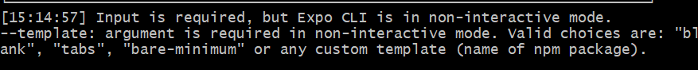
Creating a New React Native Project
Now, here’s a sad thing…
At first I tested this on my Mac, and everything was fine…
But using Git Bash on my windows machine, I got this error message

Slide 22
Creating a New React Native Project
There’s a couple of solutions!
One is to use a different shell
Like the standard command prompt
Or Windows PowerShell
Both accessible for searchin for them in your computer’s search bar.

Slide 23
Creating a New React Native Project
The other is to specify a couple of things by hand.
Namely, a Template and the Name.
We’ll use the “blank” template.
And we’ll call the app “Food”
So on Windows, using GitBash we would actually write:
npx expo-cli init food --npm --template blank –-name Food

Slide 24
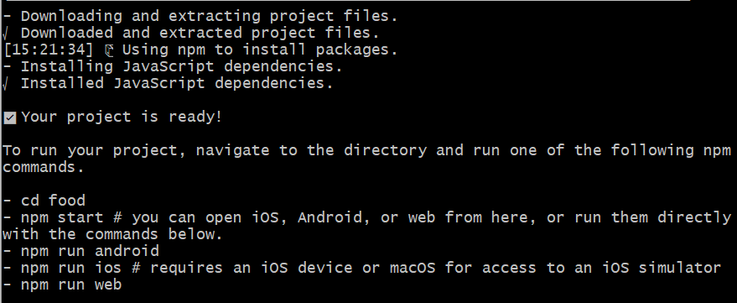
Creating a New React Native Project
If you used a mac or other shell, it will become “interactive” and you’ll have a choice to pick your template and type your name interactively.
Choose “blank” for the template, and type “Food” for the name when that happens.
Then, on both operating systems, you should see something like this.

Slide 25
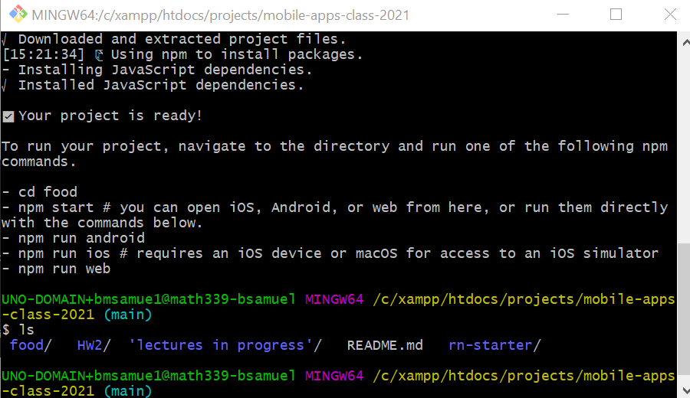
Creating a New React Native Project
And you should now have a new directory called food!
cd into it with the command
cd food

Slide 26
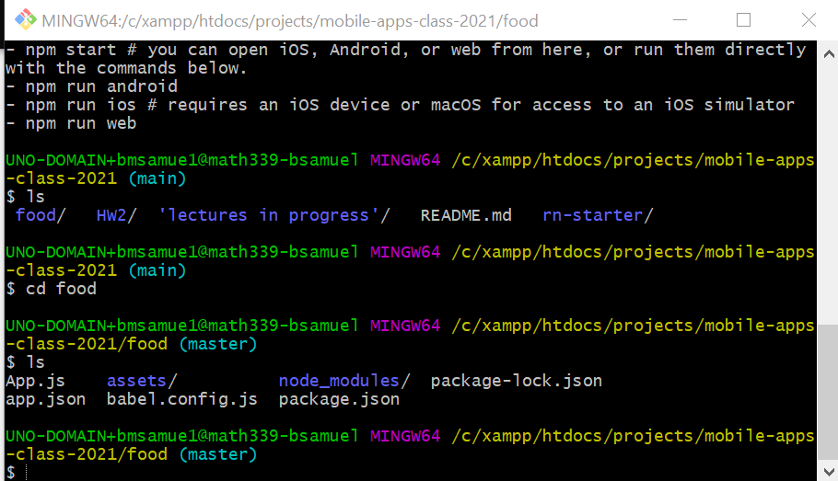
Creating a New React Native Project
And then if you type ls to see what is inside…
You should see that it looks fairly similar to our rn-starter folder!

Slide 27
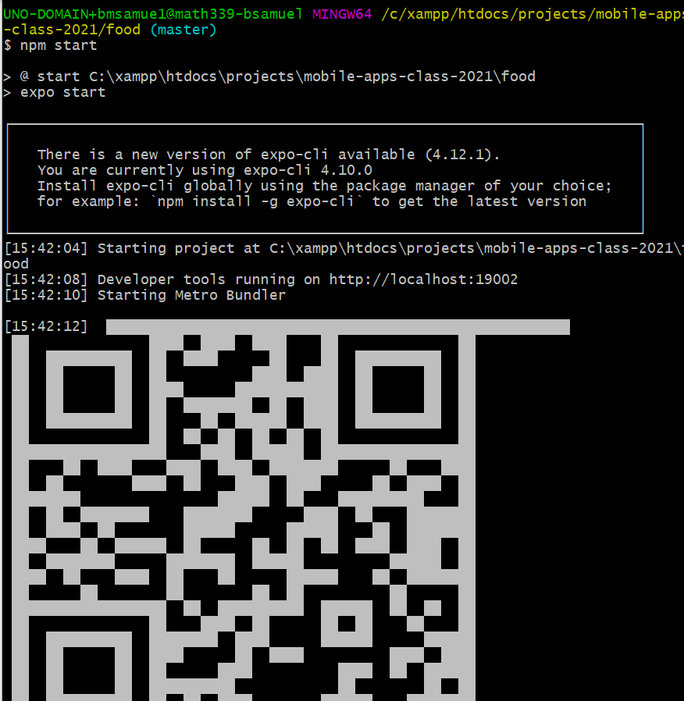
Creating a New React Native Project
At this point, you could do type npm start as before from this new directory!

Slide 28
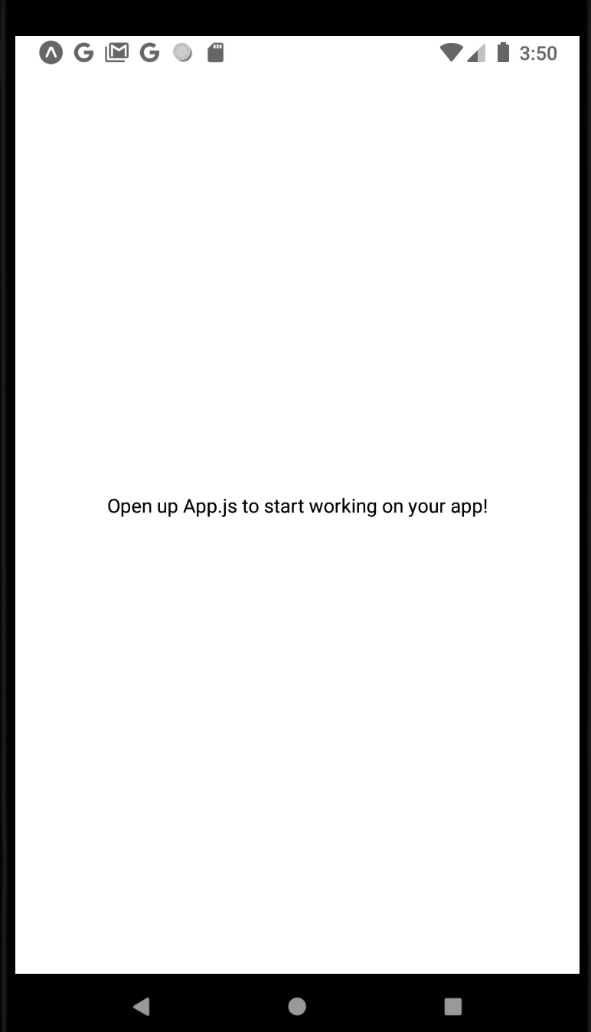
Creating a New React Native Project
But if you open this new app on your phone or an emulator…
You’ll see that it is pretty empty!
(You also may need to update Expo Go – I did)

Slide 29
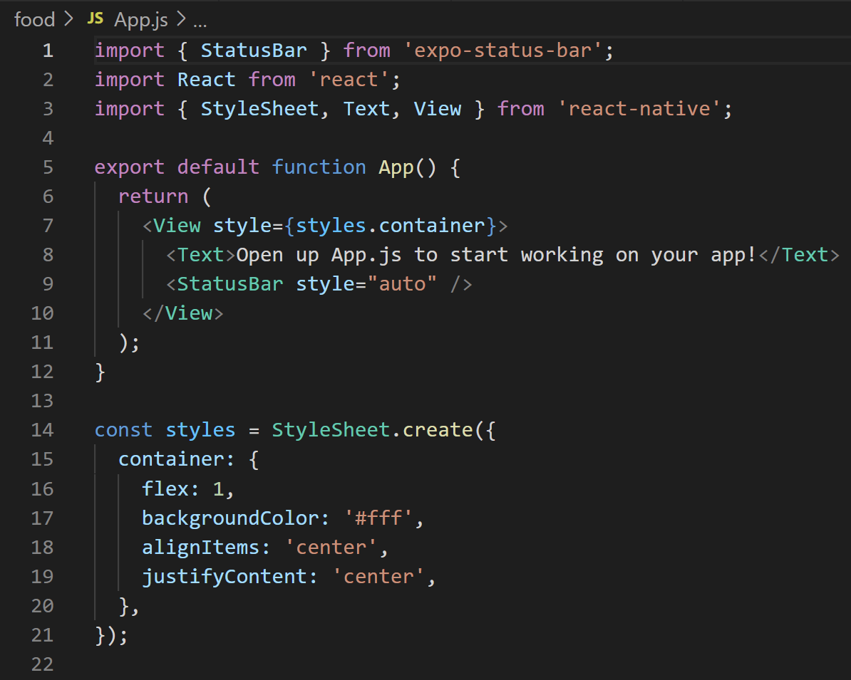
Creating a New React Native Project
And if you follow that screen’s advice and open up App.js…
You’ll see that at the moment, the new App.js file looks very different from the one in rn-starter!
It doesn’t make use of a StackNavigator yet!

Slide 30
Creating a New React Native Project
So, clearly there’s plenty of work to do still to get our app up and running.
But at least we’ve got a sandbox to play around in now!

Slide 31
Today’s Agenda
Today’s Plan
Creating a New React Native Project
Getting Started With Yelp

Slide 32
Today’s Agenda
Today’s Plan
Creating a New React Native Project
Getting Started With Yelp
Getting Navigation Set Up
Actually Building the App!
Or at least getting the search bar set up!

Slide 33
Getting Started With Yelp
I promised you that our app would actually be working with real-life Yelp data!
Let’s learn a little bit about how to get that data, using the Yelp API.
We can use this to get information about restaurants, images, and more!
And it’s *free*!
We can learn more about this API here: https://www.yelp.com/fusion

Slide 34
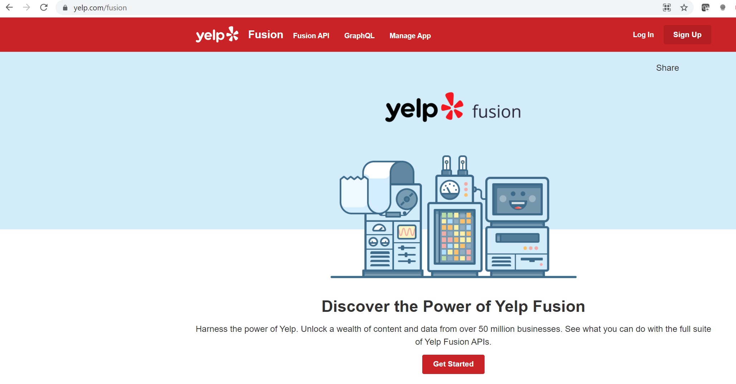
Getting Started With Yelp
Here it is! And just as a bit of future proofing: all of this is made by Yelp! It could change at any time!
Don’t be afraid to Google “Yelp API” if they change name from Fusion and you get a 404 file not found error!

Slide 35

Getting Started With Yelp
Our goal here is to get ourselves access to the Yelp API. The first thing is to log in or sign up for a Yelp account.
I have one already, because I love giving things five star reviews. So I would click “Log In” and enter my credentials.

Slide 36
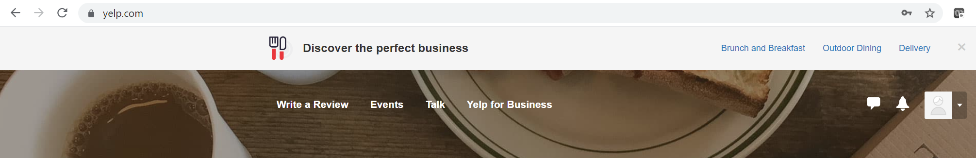

Getting Started With Yelp
When you log in, it is going to redirect you back to the homepage, Yelp.com
But we want to use the API, which (at the time of this writing) is called Fusion!
So manually add /fusion to the end of that url

Slide 37
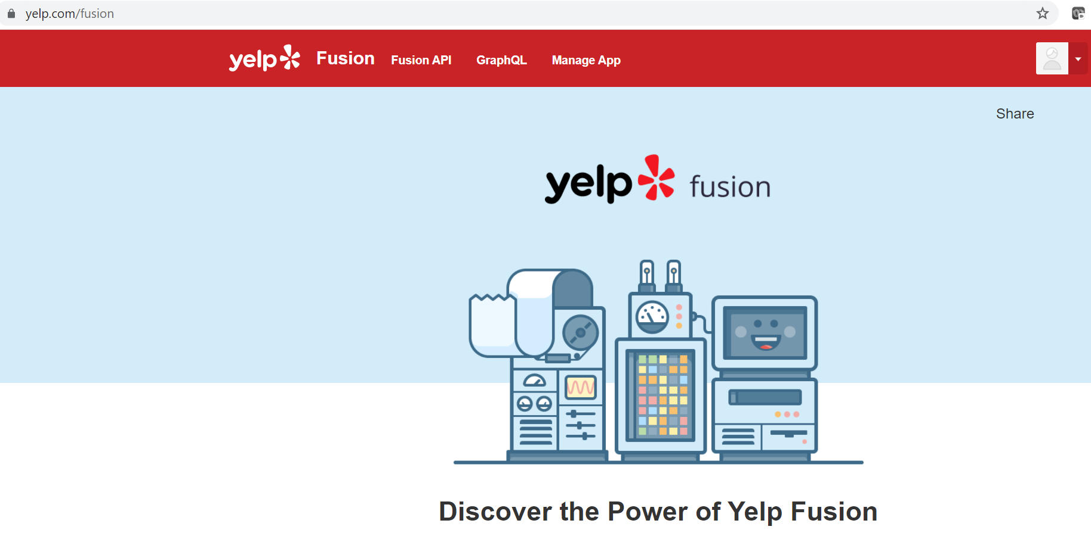
Getting Started With Yelp
And now we’re back here, but logged in this time.

Slide 38

Getting Started With Yelp
Again – these pictures may change if/when Yelp changes things. But for now, we want to find and click on that Get Started button.
That will open up the internal developers screen! A side of Yelp unseen by most users!

Slide 39
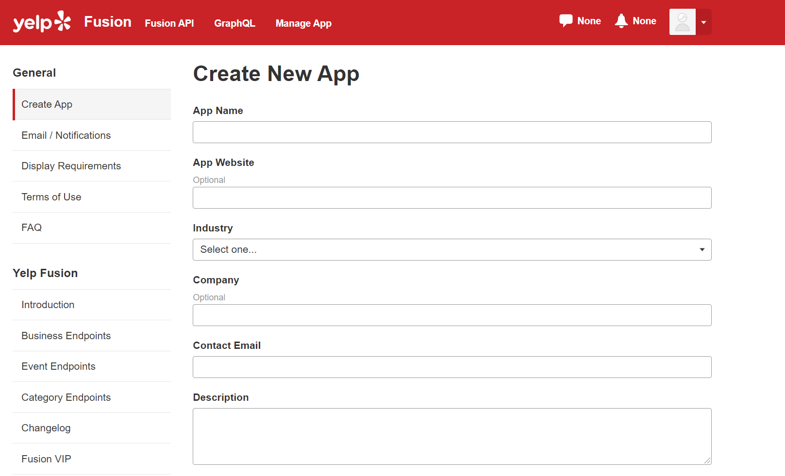
Getting Started With Yelp
It will probably look something like this!

Slide 40
Getting Started With Yelp
Our current goal right now is to get something called an API Key.
This will enable our phone app to chat with Yelp and access/use its data.
But before we can get our hands on that, we need to create an app from Yelp’s point of view.

Slide 41
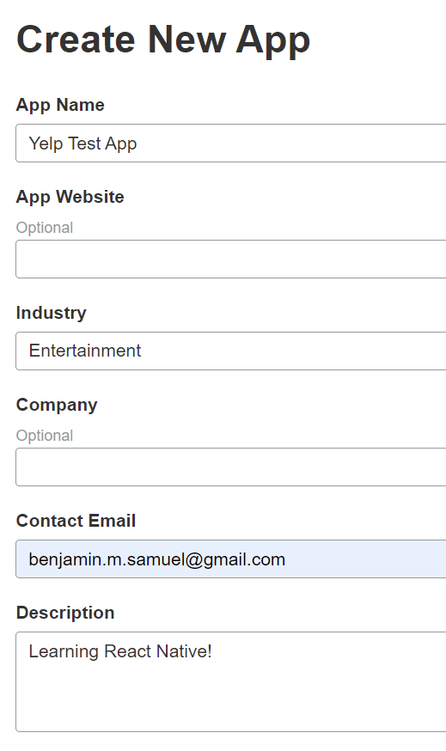
Getting Started With Yelp
You’ll need to fill out the form – don’t worry too much about what you type in here!

Slide 42
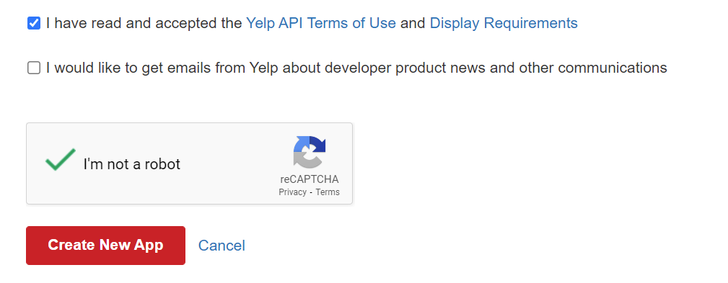
Getting Started With Yelp
Make sure you accept the API terms of use!
You probably want to uncheck the “receive emails from Yelp” box.
And, of course, prove you’re a human being.
Then push that “Create New App” button!

Slide 43
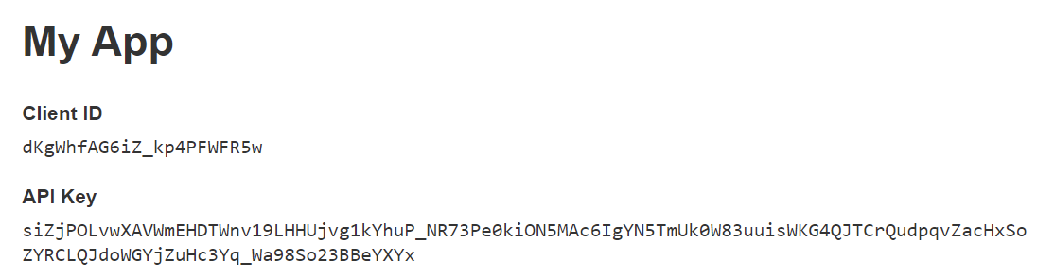
Getting Started With Yelp
You’ll then see something that looks like this!
It’s your client ID, and your API key!
In “real life”, you might want to kind of keep things secret
Typically there are limits to how many API calls you are allowed to make. If others start using MY key, it could use up API calls from my users.
But given that we’re not making anything real here, there’s not too much threat of me showing this screen to you.

Slide 44
Getting Started With Yelp
Now, we worked hard to get this stuff, but we aren’t ready to use it just yet!
Eventually, we’ll be typing both of these things into our app itself.
So having them on hand (maybe copy and pasting them and adding them as a comment in a file in your new app for now) is recommended!

Slide 45
Getting Started With Yelp
Now the question remains…
OK – we got these things…?
But how do we actually use them to allow us to make search’s through the Yelp API?

Slide 46
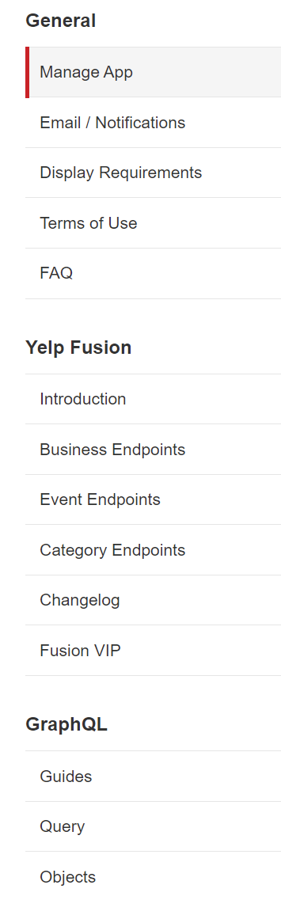

Getting Started With Yelp
Let’s chat about that right now!
First, let’s navigate to this part on the left hand side of the screen that says “Business Endpoints”

Slide 47
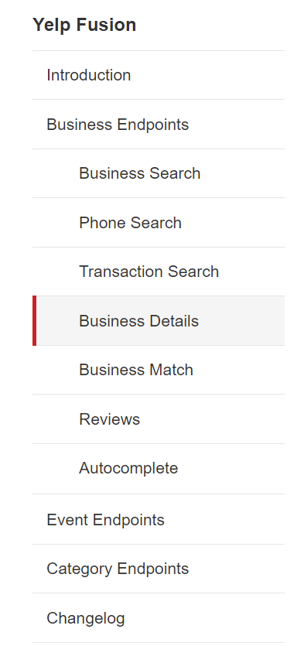

Getting Started With Yelp
When you do that, the section expands. You should see something called “Business Search.”
Let’s click on that!

Slide 48
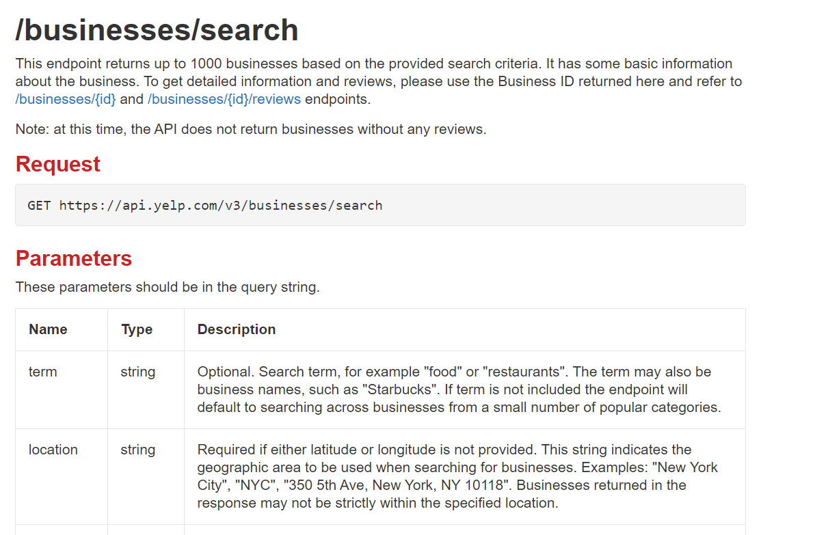

Getting Started With Yelp
This page teaches us how to initiate a search using the Yelp API.
To initiate a search, we need to initiate a GET request to the URL specified on this page.
That is:
GET https://api.yelp.com/v3/businesses/search

Slide 49



Getting Started With Yelp
We can use this to get data for up to 1,000 businesses that have info on Yelp!
But just getting info on random businesses isn’t super helpful.
We want to be able to search for specific things!
That’s where the search parameters come into play.

Slide 50


Getting Started With Yelp
We can use general search terms like “food” or “restaurants” or “Starbucks”
We can specify locations with strings.
We can even search by latitude and longitude degrees!

Slide 51
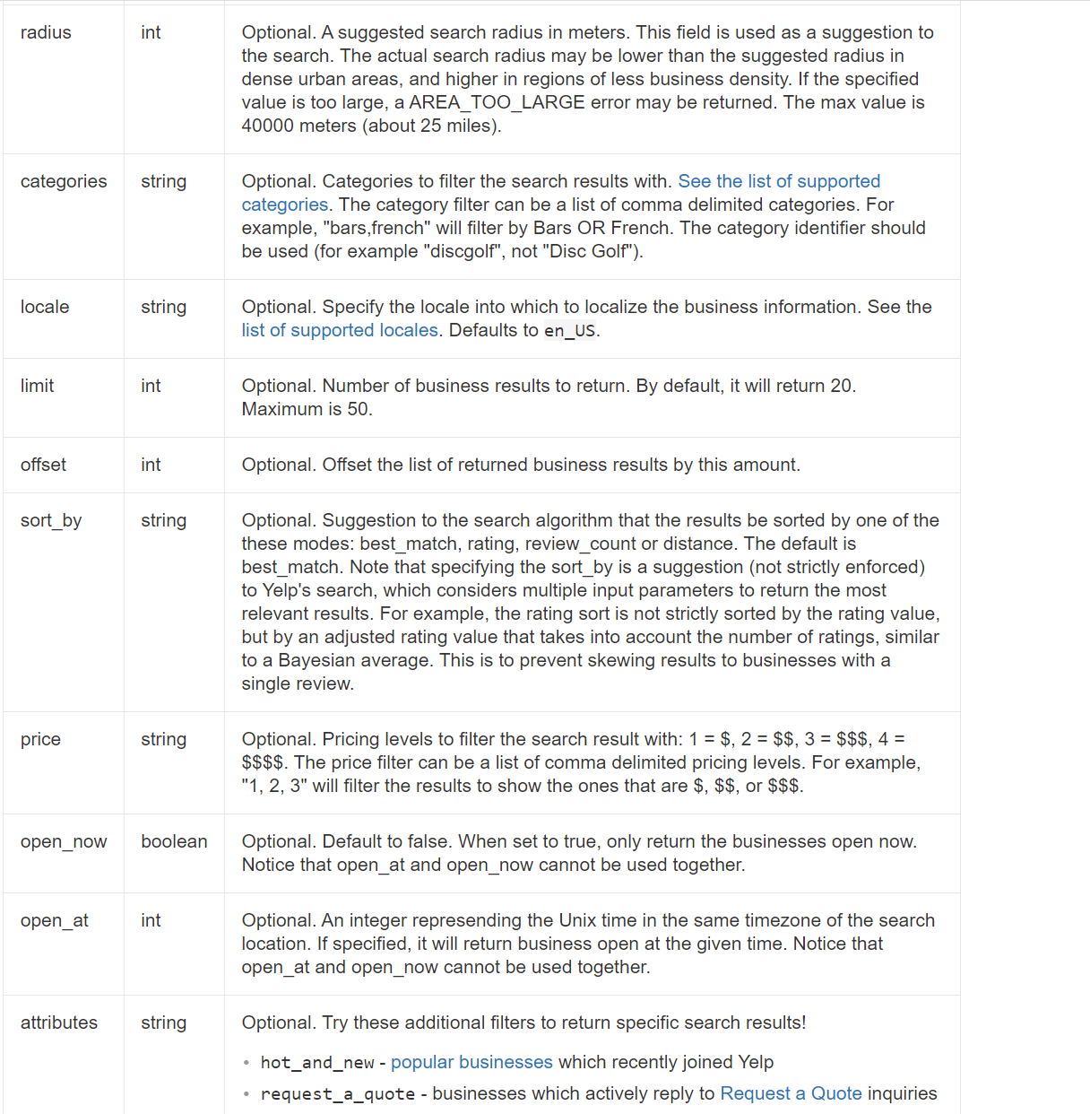
Getting Started With Yelp
You can see there’s quite a lot here, and it might be fun to explore!
And like, I’m still getting familiar with it too!
For example, this limit line seems to directly contradict what was stated above!
???
I think it’s connected to this offset option?

Slide 52
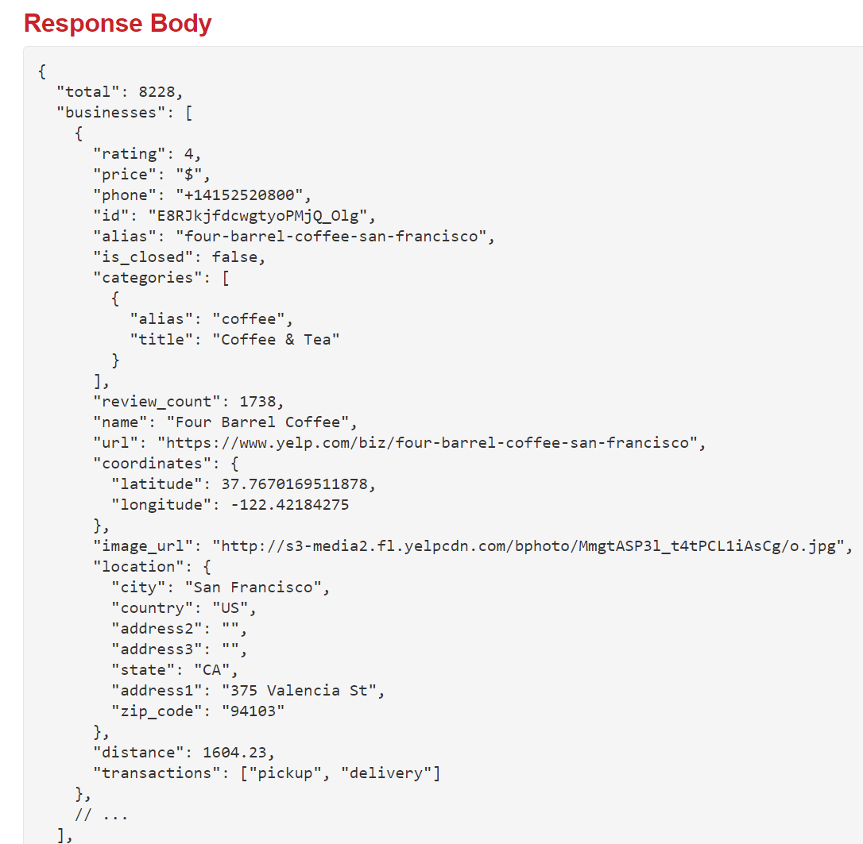
Getting Started With Yelp
ANYWAY…
When we make that GET request, with whatever search criteria we use, Yelp will give us a bunch of data, representing the businesses that matched our search.
That data looks like this!

Slide 53
Getting Started With Yelp
And I know this probably looks super long and intimidating…
But hey! It’s just a JavaScript object!
Technically we would say that this is JSON
JavaScript Object Notation
But it’s the same idea as what we’ve been seeing! Just a bunch of key-value pairs!

Slide 54

Getting Started With Yelp
The first key is “total”, and in this example, the value is 8228.
It represents how many businesses are returned.
(Yelp explains later on the page that yes, sometimes you might get more than 1,000 hits here, despite what they said before).

Slide 55

Getting Started With Yelp
Then the next key is “businesses”
We can see that the value stored in this key is an array.

Slide 56

Getting Started With Yelp
Each element of this array is going to be an object that represents ONE business.
And as we can see, we’ve got a whole lot of information to work with for that business!

Slide 57




Getting Started With Yelp
We can see what the business’ rating is…
How expensive it is…
In Yelp terms, they measure price by $ signs.
$ is inexpensive, $$$$ is super fancy.
We get the name of the business.
We get a default image to display.

Slide 58
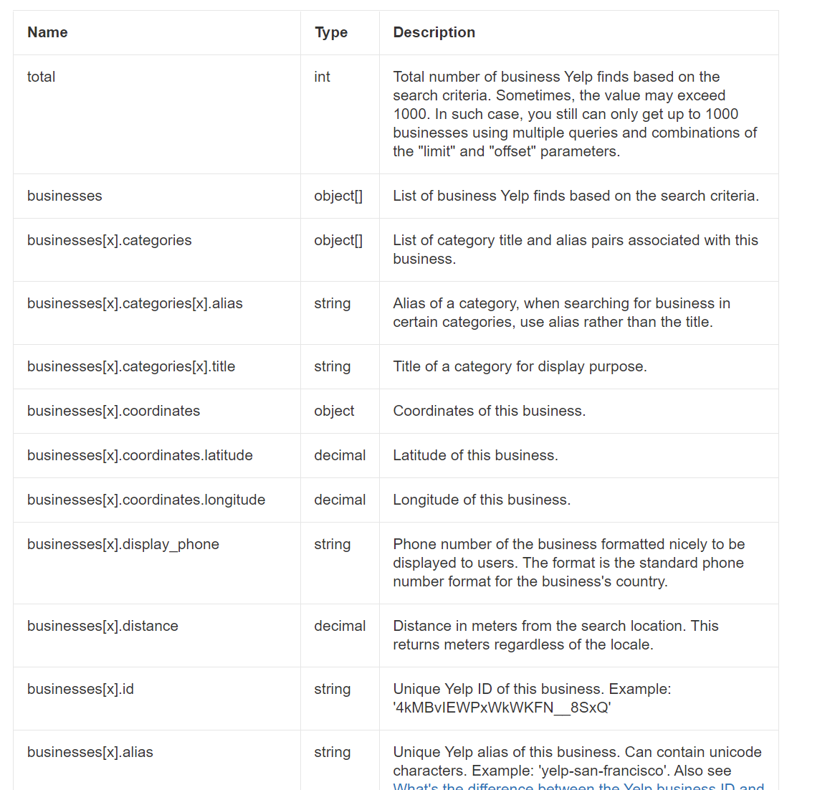
Getting Started With Yelp
So, there’s a TON of stuff there.
And Yelp actually does a pretty good job of explaining what each of those properties means if you scroll down the page.
The 1,000 businesses is still weird though…

Slide 59
Getting Started With Yelp
I imagine there’s still some mystery here for many of you.
Maybe some of you have never heard of or used a GET command before.
But I’m hoping that we’re beginning to see how what we just saw can be used to populate our mock up from before!
$ Restaurants
Restaurant
Restaurant
$$ Restaurants
Restaurant
Restaurant
$$$ Restaurants
Restaurant
Restaurant

Slide 60



Getting Started With Yelp
Our mock up had restaurants split up based on how expensive they were!
And we just saw that how expensive a restaurant is, indeed, data that Yelp can give to us!
$ Restaurants
Restaurant
Restaurant
$$ Restaurants
Restaurant
Restaurant
$$$ Restaurants
Restaurant
Restaurant

Slide 61
Getting Started With Yelp
Our mock up is being pretty vague as to what a “Restaurant” block is.
But maybe we imagine it being something like this…
Where any given “Restaurant” has…
A picture
Its name
It’s current rating
How many reviews it has.
$ Restaurants
Restaurant
Restaurant
Restaurant
Picture
$$ Restaurants
Restaurant
Restaurant
Name
$$$ Restaurants
Rating
# of Reviews
Restaurant
Restaurant

Slide 62






Getting Started With Yelp
Restaurant
Picture
Name
So cool! We can see the connections between the data we can retrieve, and how we can use that data to make our app look nice!
Rating
# of Reviews
$ Restaurants
Restaurant
Restaurant
$$ Restaurants
Restaurant
Restaurant
$$$ Restaurants
Restaurant
Restaurant

Slide 63
Getting Started With Yelp
Specific Restaurant
But here’s the thing…
All of that is great for that first screen…
But what about that second screen with extra details?
Picture
Picture
Picture

Slide 64
Getting Started With Yelp
Specific Restaurant
That second screen wanted extra pictures…
But this information we get back here only has ONE image.
Picture
Picture
Picture

Slide 65


Getting Started With Yelp
In order to do this, we’ll make use of a different endpoint of the Yelp API
i.e., we’ll make GET request to a different URL.
But one that will need specialized information!
Namely, a specific business’ id

Slide 66
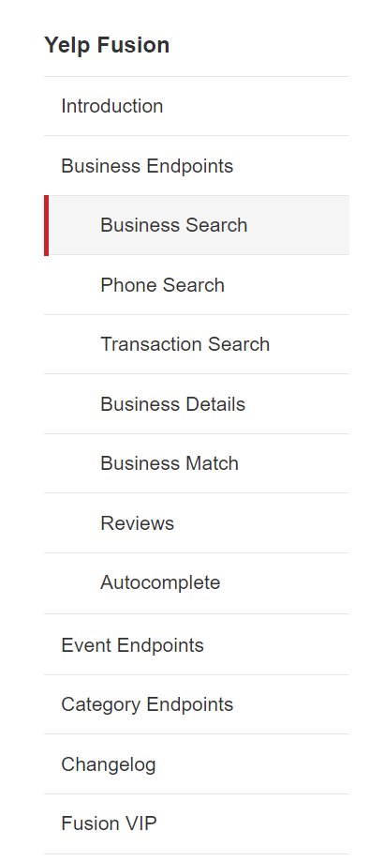

Getting Started With Yelp
Back on the Yelp webpage, if we navigate away from Business Search…
And navigate to Business Details…

Slide 67
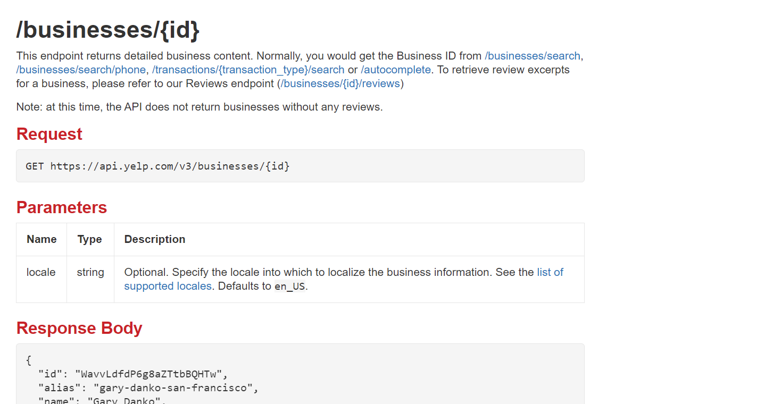

Getting Started With Yelp
We’ll see a similar screen to what we saw before.
Although this time, you can see that the GET request will need us to provide it with an id of a specific business.

Slide 68
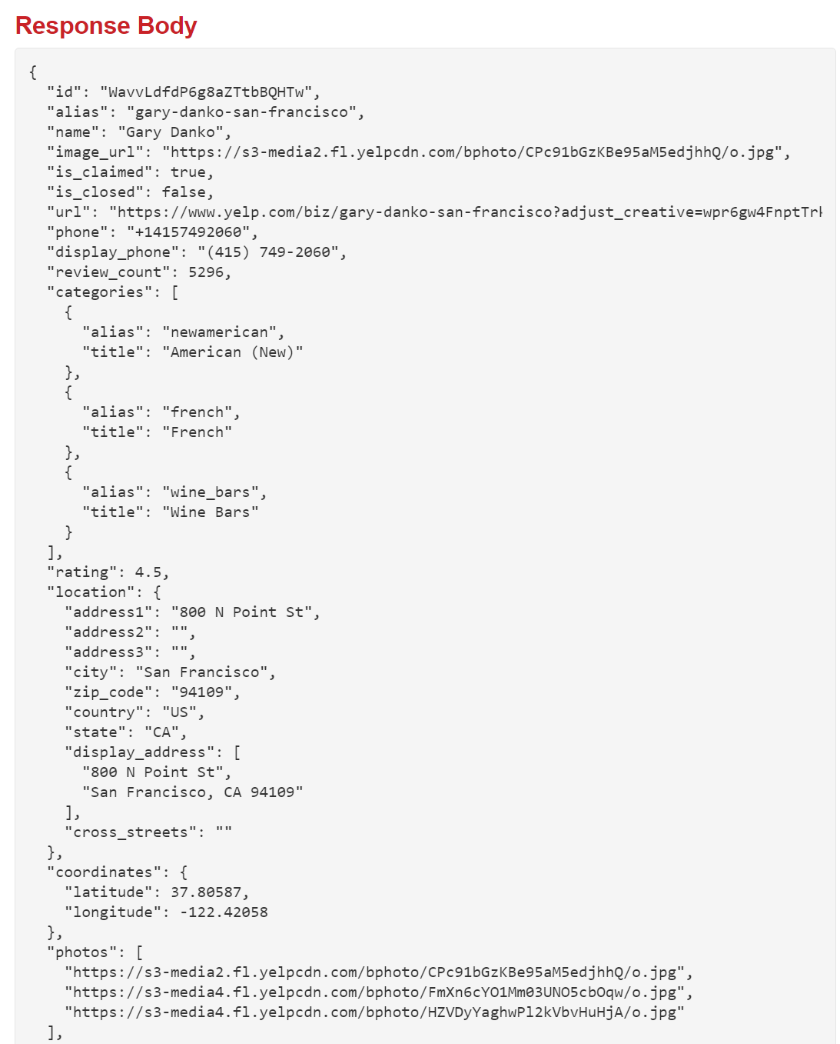


Getting Started With Yelp
And we can see that the data that THAT request provides has a lot of extra specifics.
Including some number of additional photos!
Perfect for our purposes!

Slide 69
Getting Started With Yelp
OK!
SO! At this point we have:
A brand new app!!!
That is currently more-or-less empty.
A shiny new Yelp API key!
That we don’t entirely know how to use yet.
Though once we do, we have a pretty good sense as to how we can make good use of the data it provides!

Slide 70
Getting Started With Yelp
Let’s put Yelp aside for now, and pick up our app again.
Basically: we now know *where* the data for our app is going to come from!
But we still need to worry about the actual implementation!

Slide 71
Today’s Agenda
Today’s Plan
Creating a New React Native Project
Getting Started With Yelp
Getting Navigation Set Up
Actually Building the App!
Or at least getting the search bar set up!

Slide 72
Getting Navigation Set Up.
Specific Restaurant
As you no doubt recall, our dream is to have something like this.
This is actually a very common architectural pattern you’ll find in mobile development.
$ Restaurants
Restaurant
Restaurant
Picture
$$ Restaurants
Picture
Restaurant
Restaurant
$$$ Restaurants
Picture
Restaurant
Restaurant

Slide 73
Getting Navigation Set Up.
You’ll have some kind of “Search” screen that has lots of content.
All of the Restaurants you can order off on Door Dash!
All of the previously recorded runs you’ve done on Strava!
And then you’ll be able to click on one of those options for more details.
The menu of that particular restaurant!
The details of that particular run!
Search Screen
Details Screen

Slide 74
Getting Navigation Set Up.
We’ve done navigation before!
We worked with the stack navigator!
But we haven’t really learned the full story yet.
Let’s dig in a little deeper right now.
Search Screen
Details Screen

Slide 75
Getting Navigation Set Up.
There exists the React Navigation Library for us to make use of.
It provides a number of different objects and tools to allow users to navigate around an app.
Those objects are…
The DrawerNavigator
The BottomTabNavigator
The StackNavigator

Slide 76
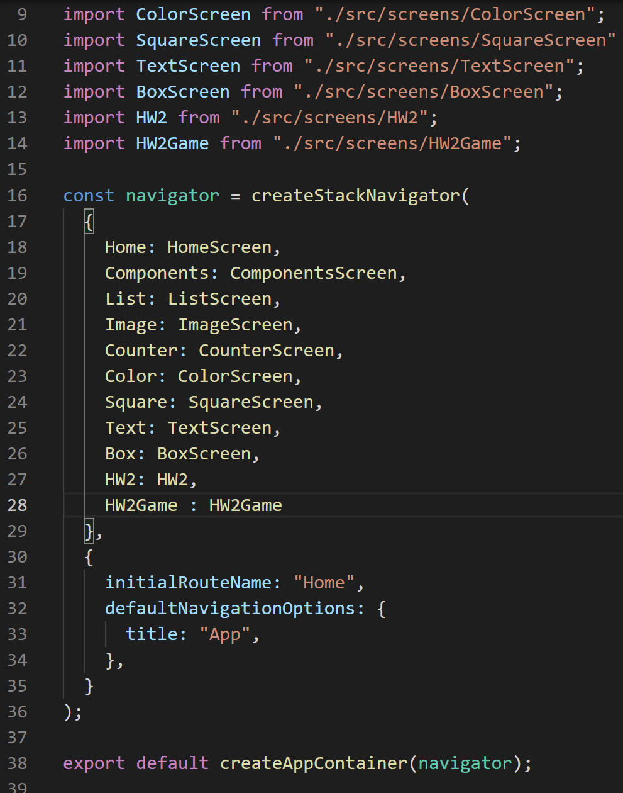
Getting Navigation Set Up.
As we already saw with our StackNavigator fiddling before…
The basic premise of all of these objects is the same: we will wire together screens (i.e., components) in some automatic fashion that lets us jump between them.

Slide 77
Getting Navigation Set Up.
Home
Details
So far, we’ve been using the StackNavigator object.
The term “Stack” here is similar to Stacks as you know them from your other CS courses!
Click me to see more details!
Details go here

Slide 78
Getting Navigation Set Up.
Home
Details
When we visit a page, it gets added to the stack.
So, we open our app, and Home is on it.
Click me to see more details!
Details go here
Home

Slide 79
Getting Navigation Set Up.
Home
Details
And then when we click a button and go to a new screen, that new screen gets added to the top of the stack!
Click me to see more details!
Details go here
Details
Home

Slide 80
Getting Navigation Set Up.
Home
Details
If we then click on the “back” button on the new screen, it pops that screen off the stack!
Bringing us back to “home” in this case.
Click me to see more details!
Details go here
Details
Home

Slide 81
Getting Navigation Set Up.
Home
Details
To be clear: those nice headers at the top of the screen…
Those nice back buttons that have been showing up…
We only get those for free because we are using StackNavigation.
Click me to see more details!
Details go here

Slide 82
Getting Navigation Set Up.
Home
As an alternative to StackNavigation, there is also the BottomTabNavigator.
It shows a little menu along the bottom edge of the phone, that you can click on to take you to different screens.
blah blah bal
Home Photos Blog

Slide 83
Getting Navigation Set Up.
Home
Home
Photos
Blog
API Demo
The DrawerNavigator makes it so that a little “drawer” will come out of the side of the screen, with a menu of options.
And clicking on one of those options takes you to a different page.
blah blah bal

Slide 84
Getting Navigation Set Up.
For our purpose for this app, the StackNavigator seems the most suitable!
But here’s the thing! We will have to actually do some work to set up React Native navigation!
And it’s always easiest to do that at the start, when you are first making a new project.

Slide 85
PART 1 ENDS – PART 2 BEGINS!

Slide 86
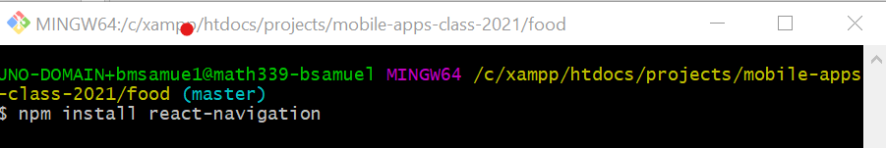
Getting Navigation Set Up.
So, to install the react navigation library in our new project…
Navigate to your new project directory
So for us, that would be ‘food’
And type the following:
npm install react-navigation

Slide 87
Getting Navigation Set Up.
However, *that’s not all!*
You’ll also need to do the following to install dependencies:
expo install react-native-gesture-handler react-native-reanimated react-native-screens react-native-safe-area-context @react-native-community/masked-view
Notes:
Note that we are using React Navigation v4

Slide 88
Getting Navigation Set Up.
However, *that’s STILL not all!*
You’ll also need to install the React Navigation Stack
npm install react-navigation-stack @react-native-community/masked-view
Notes:
Note that we are using React Navigation v4

Slide 89
Getting Navigation Set Up.
And then you may need to start your app in a special way, by clearing its cache:
expo r -c
Notes:
Note that we are using React Navigation v4

Slide 90
Getting Navigation Set Up.
And then, if your experience is like mine, you might need to start and stop the bundler several times before it finally figures itself out.
And wait some time while it rebuilds the cache, without giving you any feedback.
It was a little bit of a frustrating process for me, in all honesty!
Notes:
Note that we are using React Navigation v4

Slide 91
Getting Navigation Set Up.
And then, if your experience is like mine, you might need to start and stop the bundler several times before it finally figures itself out.
And wait some time while it rebuilds the cache, without giving you any feedback.
It was a little bit of a frustrating process for me, in all honesty!
Notes:
Note that we are using React Navigation v4

Slide 92
Getting Navigation Set Up.
But then, after you do all that, you should now, in theory, have a brand spankin’ new react native project to work with!
Again, the commands that you need to enter are:
npm install react-navigation
expo install react-native-gesture-handler react-native-reanimated react-native-screens react-native-safe-area-context @react-native-community/masked-view
npm install react-navigation-stack @react-native-community/masked-view
expo r -c
Notes:
Note that we are using React Navigation v4

Slide 93
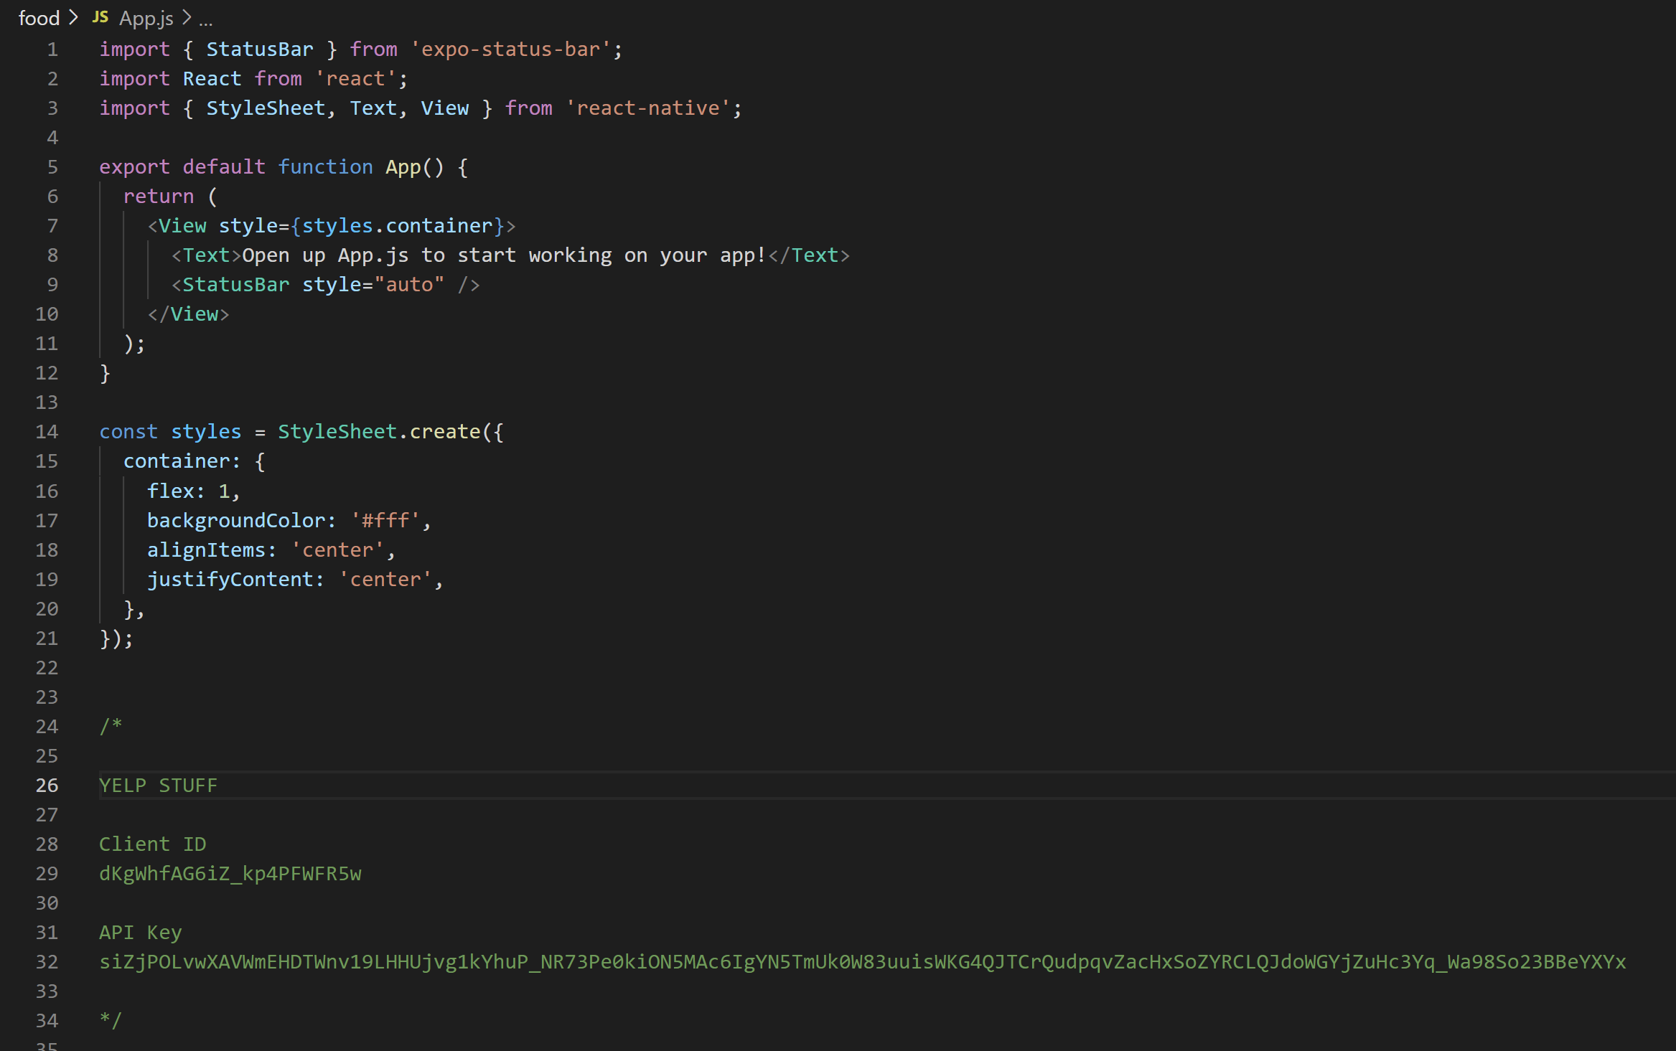
Getting Navigation Set Up.
So, great!
Now that we have all this stuff installed, we can start “importing” stuff from it, in the same way that we’ve imported components and objects and functions previously! Navigate to your new App.js file

Slide 94
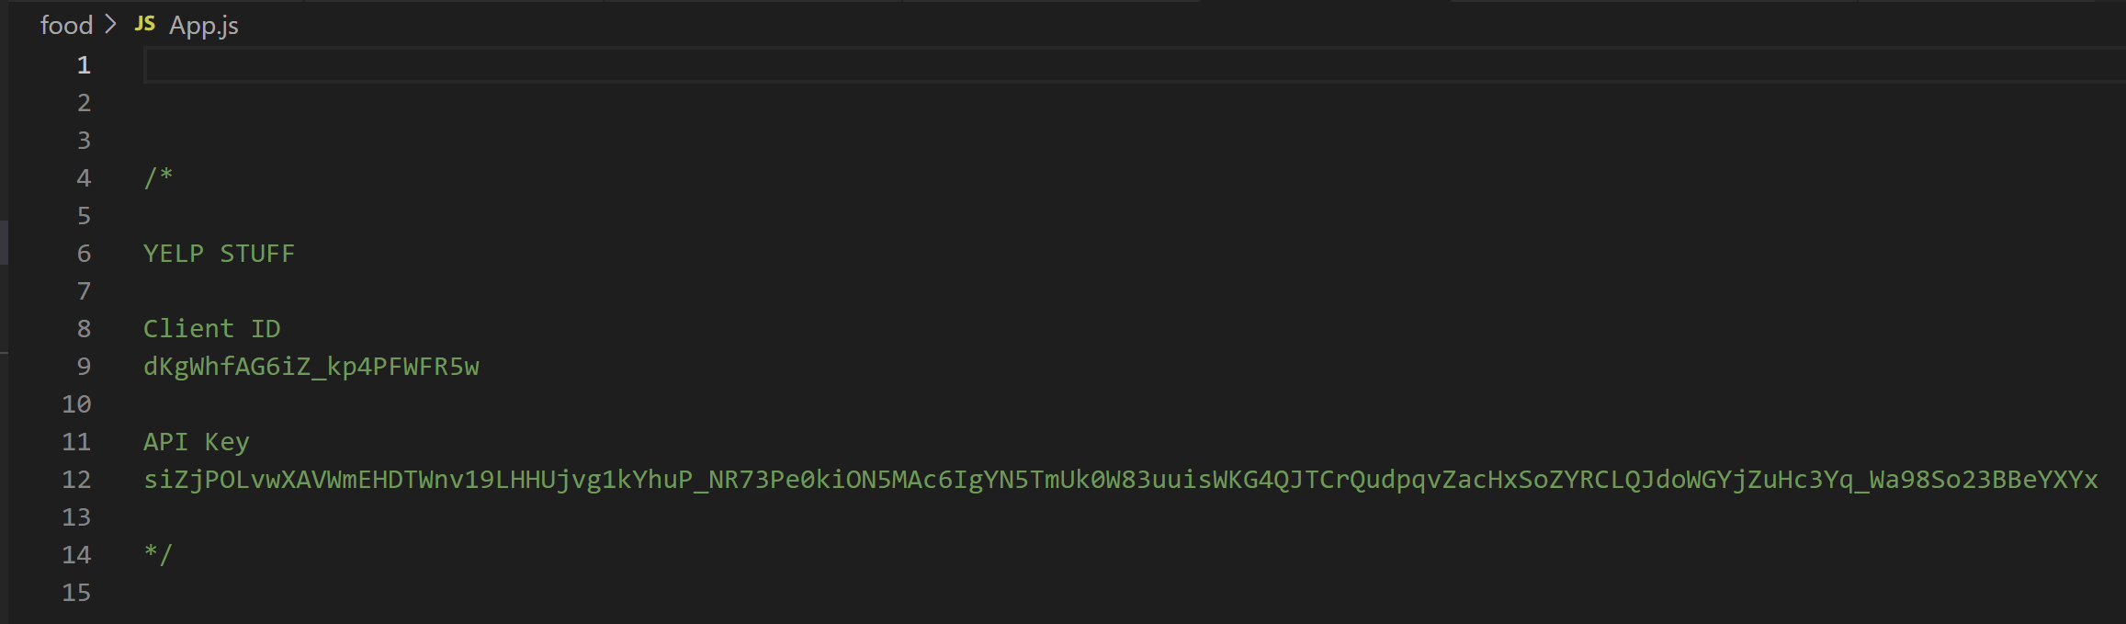
Getting Navigation Set Up.
And basically delete all of it!
I’m leaving behind my Yelp stuff in here just so that I can refer to it for later.
We can then build up this react navigation stuff from scratch!

Slide 95
Getting Navigation Set Up.
We’ll begin by importing two very specific pieces from the react navigation library!
The createStackNavigator is a function that we will (soon) call to actually *create* our stack navigator.
The createAppContainer is another function that will (eventually) take as input the stack navigator that we end up creating.

Slide 96
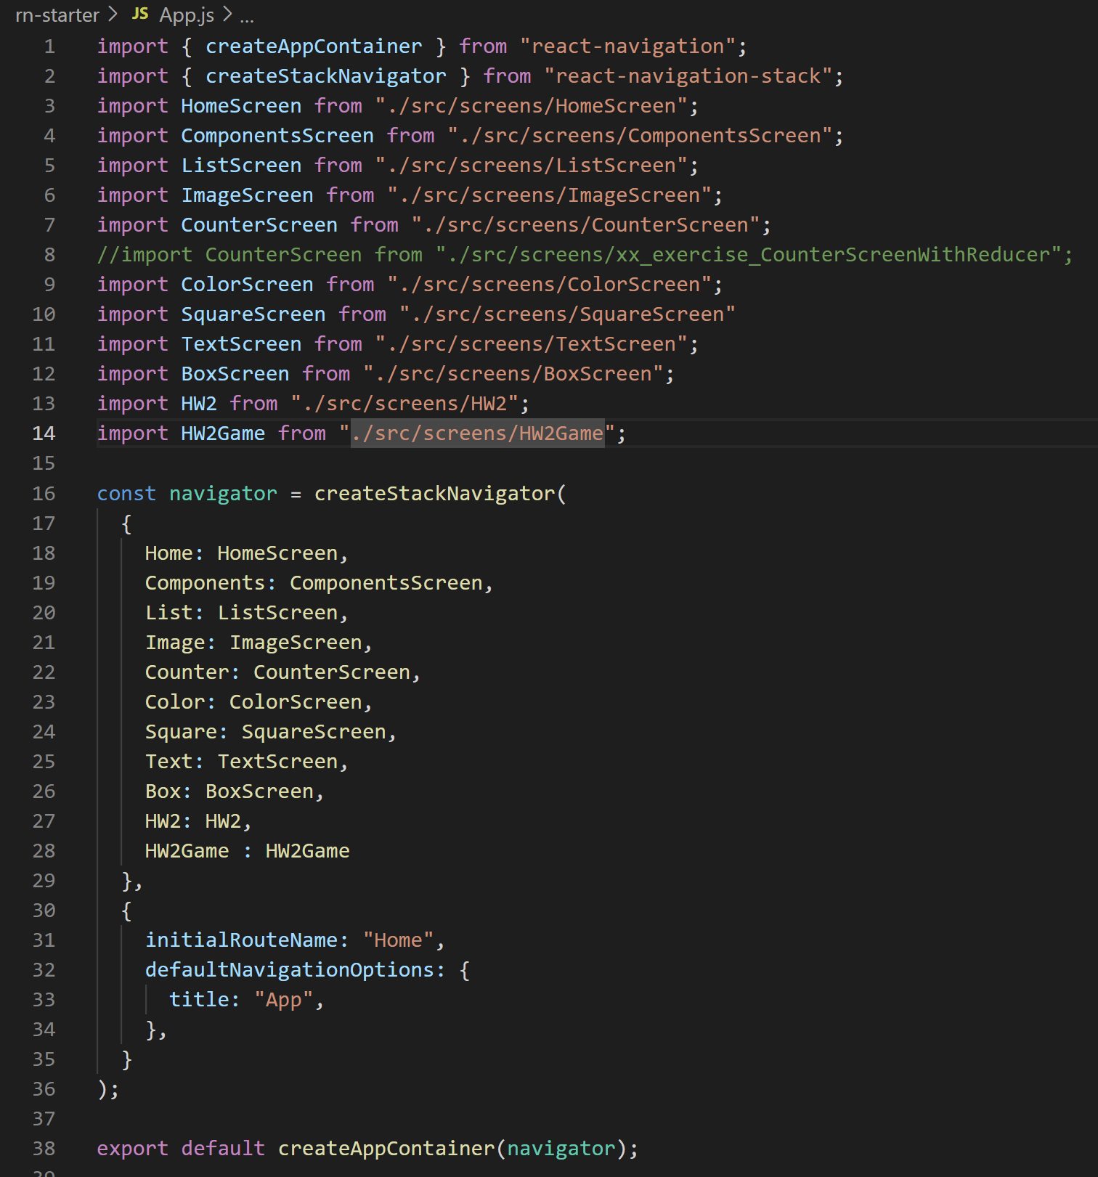
Getting Navigation Set Up.
*New* App.js
While we are doing this, it might be fun for you to compare and contrast this new file to the old App.js we were working on for our previous projects!
You’ll see that, slowly but surely the new one will look like the old one!
*Old* App.js

Slide 97
Getting Navigation Set Up.
*New* App.js
You can see that “what comes next” in the old one were references to all of the screens that we made by hand.
In order to make a StackNavigator, we need to provide it with at least one screen.
So let’s make a placeholder one now really fast!
*Old* App.js

Slide 98
Getting Navigation Set Up.
Search Bar!
It will be a file that will eventually blossom into this starting screen.
Let’s call it the “SearchScreen.js” since it will ultimately be a screen used for searching for restaurants!
$ Restaurants
Restaurant
Restaurant
$$ Restaurants
Restaurant
Restaurant
$$$ Restaurants
Restaurant
Restaurant

Slide 99
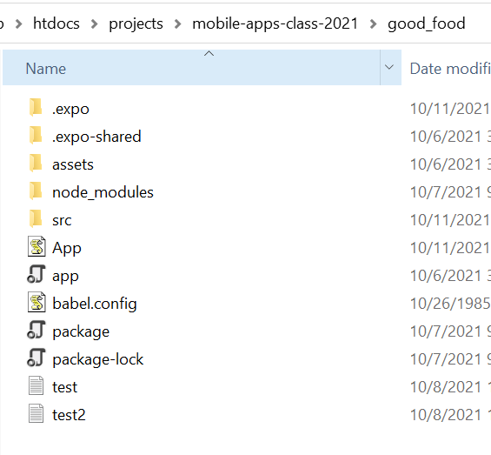
Getting Navigation Set Up.
When we created our new project, you’ll notice that it didn’t actually come with a src folder.
Recall:
In our previous project, we had a src directory
Inside of it, we had two subdirectories:
screens – for “whole screens”
components – for “reusable components”
Let’s recreate that here!

Slide 100
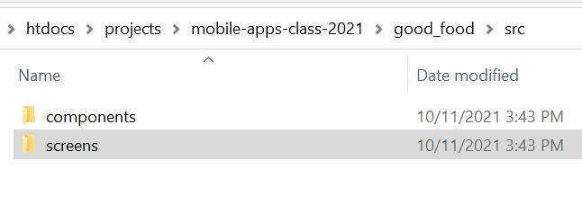
Getting Navigation Set Up.
In whichever way you prefer, add a new ‘src’ directory to your new project.
And then, inside of the newly created src directory, create two subdirectories
components
screens

Slide 101
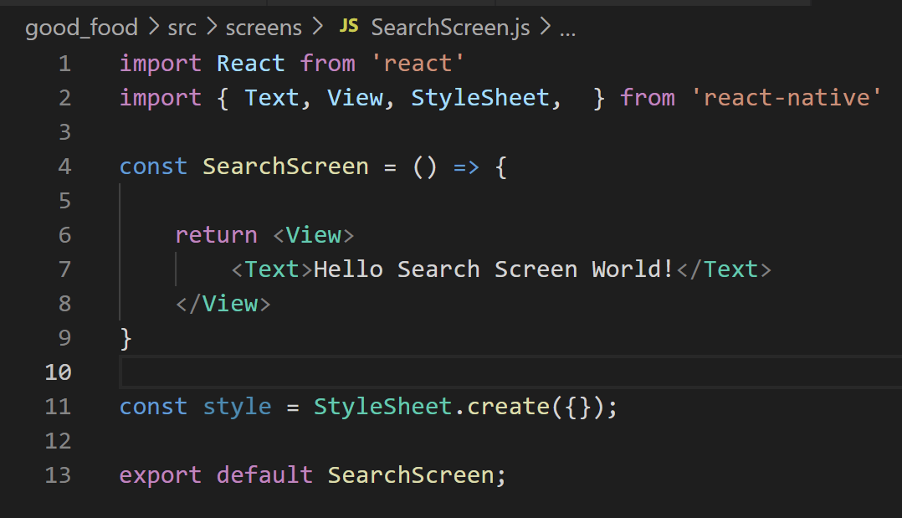
Getting Navigation Set Up.
And now we can make SearchScreen.js the first file in our newly created screens directory!
Filling it in with kind of boilerplate-y, placeholder-ey code for now.
SearchScreen.js

Slide 102
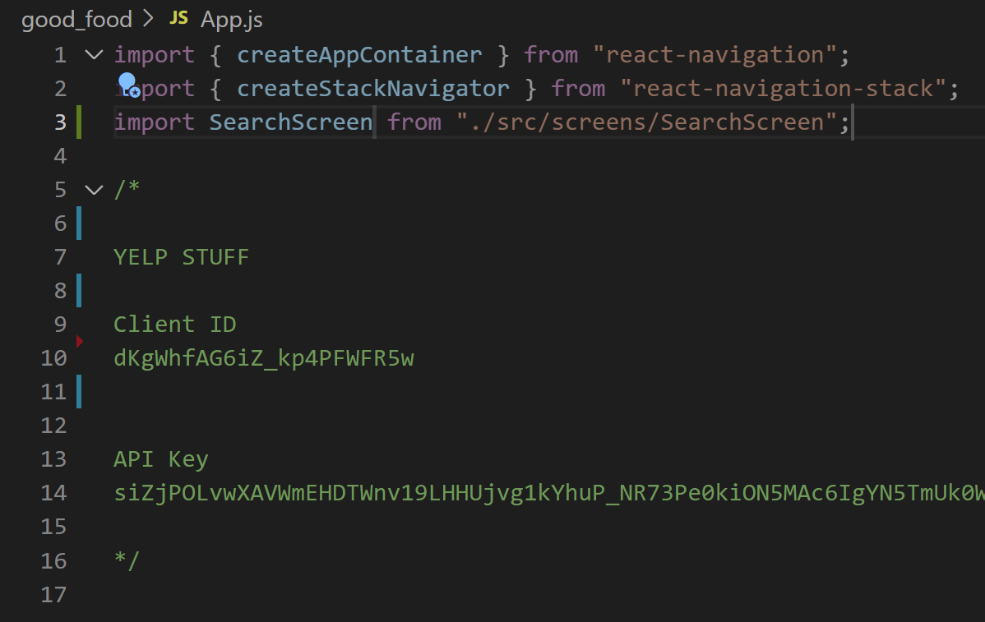
Getting Navigation Set Up.
And with that, we can now import it!
Cool, we’re importing a screen, but how to use it..?
App.js

Slide 103
Getting Navigation Set Up.
Well, again, in our previous project, we then made a stack navigator, using the createStackNavigator function that we imported from the react-navigation-stack library.
*OLD App.js*

Slide 104
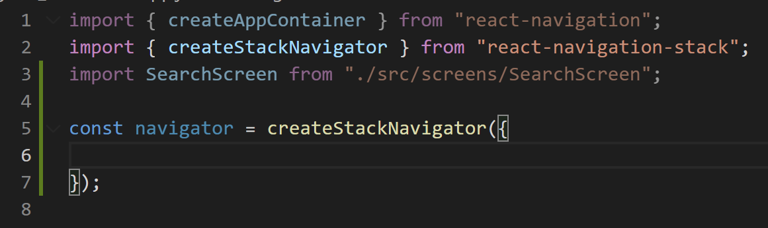
Getting Navigation Set Up.
So let’s do that!
We’ll make a new variable called navigator to store our stack navigator.
And then we’ll call that function to create it!
App.js

Slide 105
Getting Navigation Set Up.
The createStackNavigator function takes in two arguments.
The first argument is an object that lists out all the different routes that our project has.
i.e., the different screens.
App.js

Slide 106
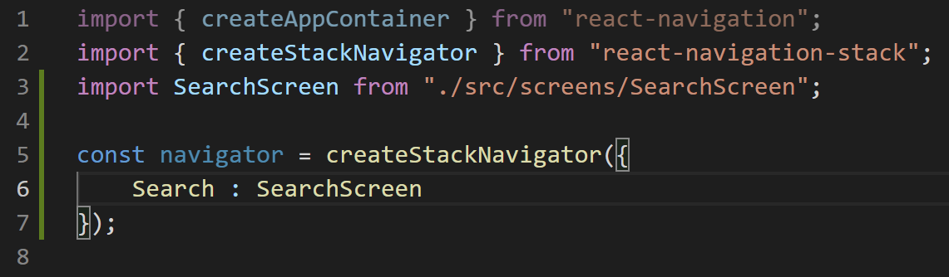
Getting Navigation Set Up.
So, something like this.
Here, the key “Search” gets to be whatever we want to call it.
And we will refer to screens by this key later on.
And the value of the key needs to match the name of the screen that we import.
App.js

Slide 107
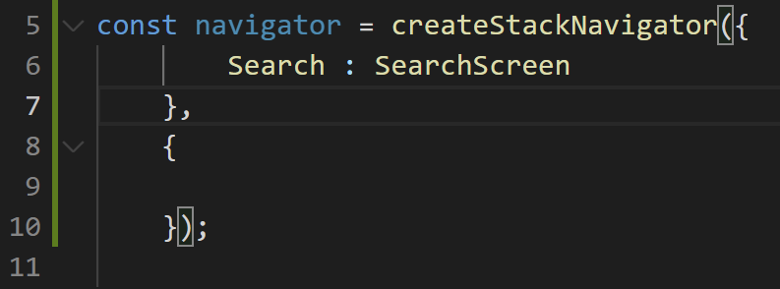
Getting Navigation Set Up.
And now we move on to the second argument into the function.
It is another object (at present, empty in this screenshot).
But soon, we will specify a few “options” for how we want our stack navigator to work.
App.js

Slide 108
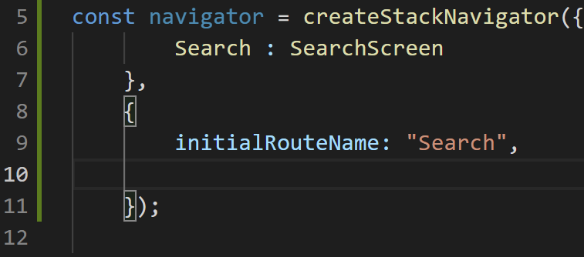
Getting Navigation Set Up.
The first is initialRouteName.
We’ve seen this before! But as a reminder…
It lets you specify the name of the key from the previous object that points to what screen you want to start on.
Here, we’ll start on the Search screen.
App.js

Slide 109
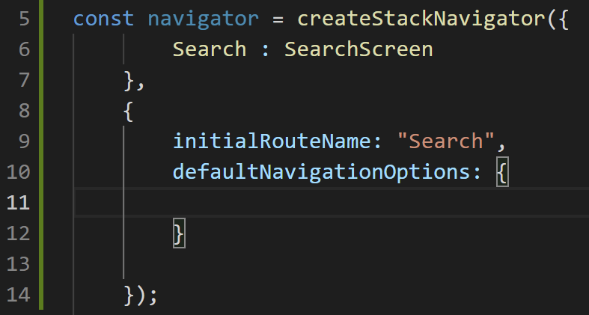
Getting Navigation Set Up.
The second is defaultNavigationOptions.
as you can see, its value will be yet another object!
Things we specify here will effect every screen of our app.
For example, we can customize the header that appears at the top of every screen.
App.js

Slide 110
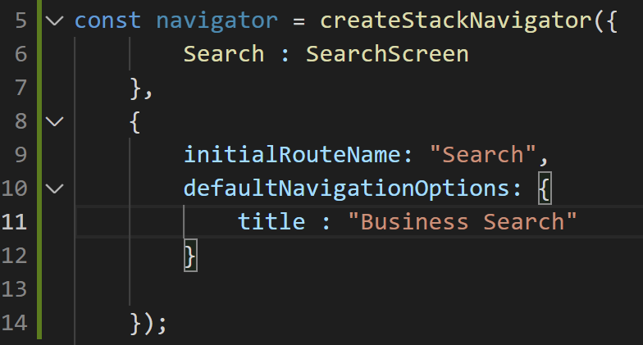
Getting Navigation Set Up.
For instance, by specifying a title property in this object, we can specify what we want the ‘title’ of each screen to be.
Now “Business Search” will appear at the top of each screen of our app.
That’ll be the only default option we add for now.
App.js

Slide 111
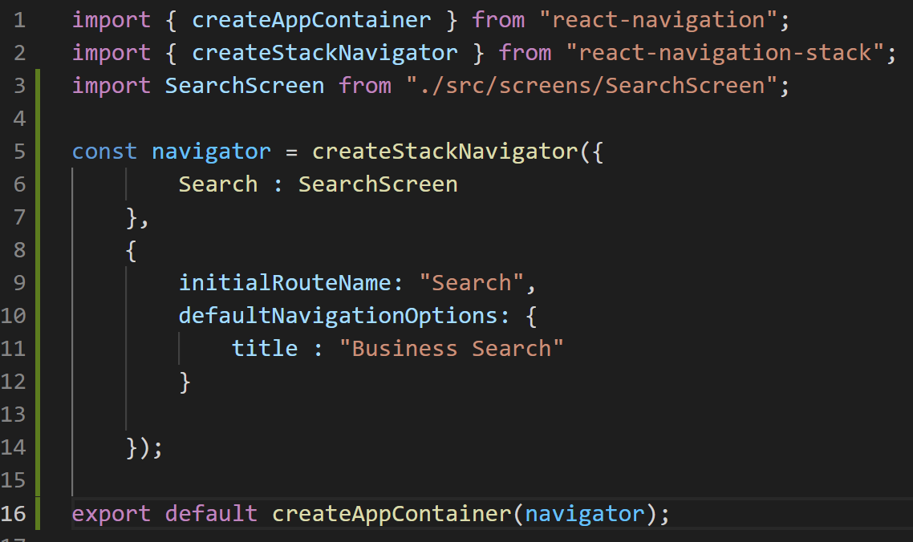
Getting Navigation Set Up.
The last thing that we need is this export line right here.
We’ve exported plenty of stuff before!
But what is going on with createAppContainer?
App.js

Slide 112
Getting Navigation Set Up.
As it turns out, App.js is a very special file.
When our application starts up, anything we export from this file gets taken by React Native and is automatically shown on the screen.
The upshot: we always needs to export a component from this file.
Just like how we export components from all of our other files too!
App.js

Slide 113
Getting Navigation Set Up.
The thing is, as we can see, we don’t HAVE a component here!
We’re not returning JSX with View and Text and whatever!
We’re creating this stack navigator instead.
App.js

Slide 114
Getting Navigation Set Up.
So what createAppContainer does is essentially *take* our stack navigator as input…
And creates a react component and displays whatever content our navigator produces inside of that component.
You can think of it as saying “export my stack navigator as a react component”
App.js

Slide 115
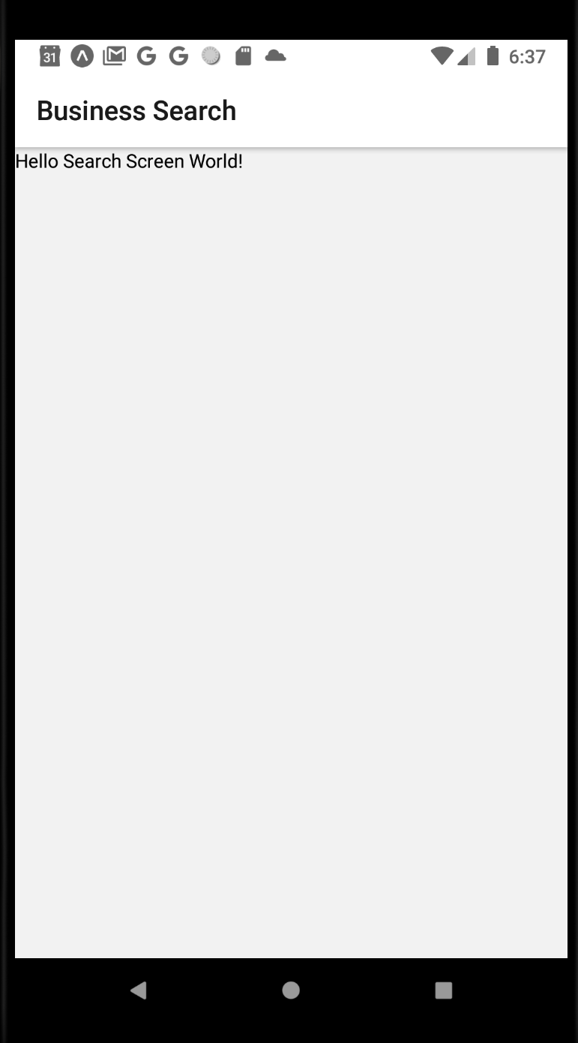
Getting Navigation Set Up.
And so then, after ALL of that, we are left with…
Basically the exact same kind of screen we are used to seeing .
BUT!
We learned more about the specifics of Navigation
And we created a brand new project and learned a little bit about all the freaking things you need to import for it.

Slide 116
Today’s Agenda
Today’s Plan
Creating a New React Native Project
Getting Started With Yelp
Getting Navigation Set Up
Actually Building the App!
Or at least getting the search bar set up!

Slide 117
Actually Building the App
Search Bar!
OK. So. What were we trying to do again?
Oh yeah, something like this.
$ Restaurants
Picture
Picture
Name
Name
Rating
Rev. #
Rating
Rev. #
$$ Restaurants
Picture
Picture
Name
Name
Rating
Rev. #
Rating
Rev. #
$$$ Restaurants
Picture
Picture
Name
Name
Rating
Rev. #
Rating
Rev. #

Slide 118
Actually Building the App
Search Bar!
So, at this point, before we begin but we have the screen planned out like this…
It’s usually a smart idea to identify anything that can be a reusable component.
Any good candidates here?
$ Restaurants
Picture
Picture
Name
Name
Rating
Rev. #
Rating
Rev. #
$$ Restaurants
Picture
Picture
Name
Name
Rating
Rev. #
Rating
Rev. #
$$$ Restaurants
Picture
Picture
Name
Name
Rating
Rev. #
Rating
Rev. #

Slide 119

Actually Building the App
Search Bar!
Well, perhaps the ‘obvious’ choice is the thing that’s very clearly been copy and pasted a bunch!
$ Restaurants
Picture
Picture
Restaurant
Picture
Name
Name
Rating
Rev. #
Rating
Rev. #
$$ Restaurants
Picture
Picture
Name
Name
Name
Rating
# of Reviews
Rating
Rev. #
Rating
Rev. #
$$$ Restaurants
Picture
Picture
Name
Name
Rating
Rev. #
Rating
Rev. #

Slide 120
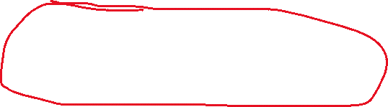
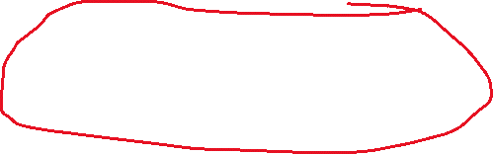

Actually Building the App
Search Bar!
But that doesn’t seem to be the only thing that repeats, yeah?
The whole restaurant list for each price point is basically the same thing three times!
$ Restaurants
Picture
Picture
Name
Name
Rating
Rev. #
Rating
Rev. #
$$ Restaurants
Picture
Picture
Name
Name
Rating
Rev. #
Rating
Rev. #
$$$ Restaurants
Picture
Picture
Name
Name
Rating
Rev. #
Rating
Rev. #

Slide 121

Actually Building the App
Search Bar!
And you know what?
Even though at present it isn’t being re-used per se, we probably want that search bar to be a custom component as well!
$ Restaurants
Picture
Picture
Name
Name
Rating
Rev. #
Rating
Rev. #
$$ Restaurants
Picture
Picture
Name
Name
Rating
Rev. #
Rating
Rev. #
$$$ Restaurants
Picture
Picture
Name
Name
Rating
Rev. #
Rating
Rev. #

Slide 122
Actually Building the App
Search Bar!
SearchBar
So maybe something like this!
Now, we could start wherever, but maybe it makes more sense to start with the SearchBar.
This is ultimately how we will “search” the data from the Yelp API that populates the restaurant list.
$ Restaurants
Picture
Picture
Name
Name
Rating
Rev. #
Rating
Rev. #
$$ Restaurants
Picture
Picture
RestaurantList
Name
Name
Rating
Rev. #
Rating
Rev. #
$$$ Restaurants
Picture
Picture
Name
Name
Rating
Rev. #
Rating
Rev. #

Slide 123
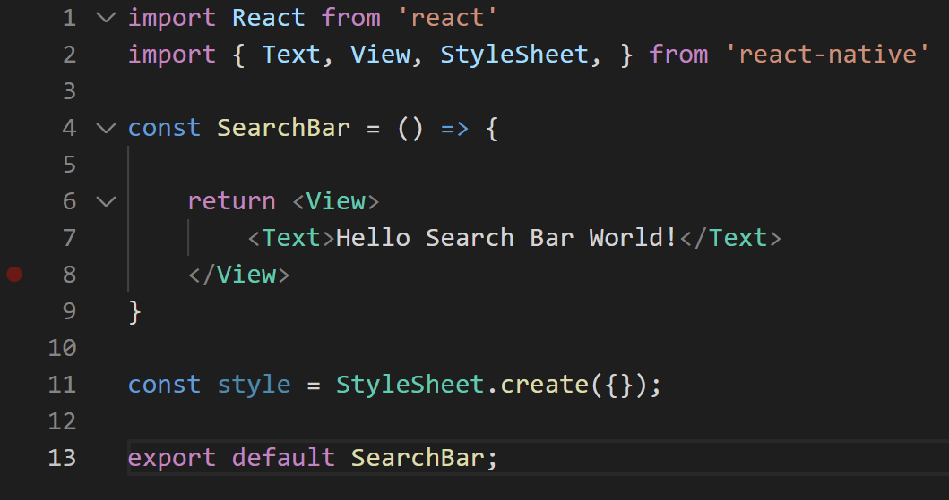
Actually Building the App
So if we are making our own SearchBar component, we will, as always, want to make a new file for it, called SearchBar.js
And it can live in that nice components folder we just made for it.
And you know me, I like to fill it up with that default stuff first thing.
SearchBar.js

Slide 124
Actually Building the App
OK, we got that!
Now, I’ve been playing a little fast and loose with my SearchBar mockup.
What’s displayed to the right is fine, but like… it isn’t really how search bars usually look right?
Search Bar!

Slide 125
Actually Building the App
Something like this looks a little nicer, right?
Maybe a cool magnifying glass icon or something!
And maybe some grayed-out, default text so that people know what that box is expecting.
And maybe the background is grey?
With no borders?
And of course, it needs to accept text input!
Search

Slide 126
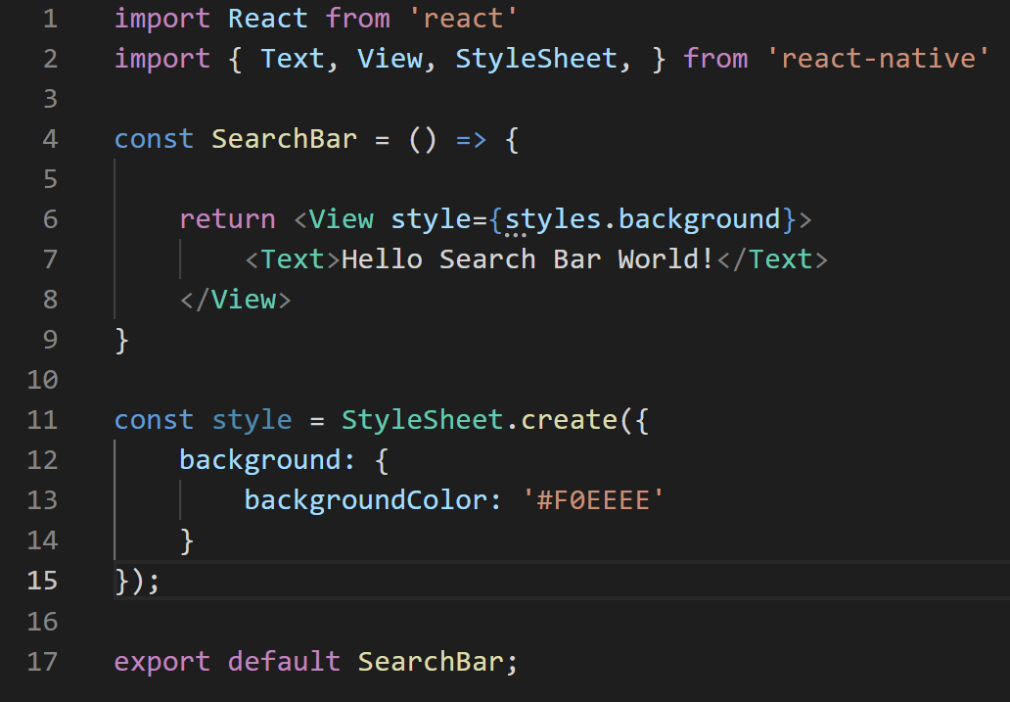
Actually Building the App
Search
A lot of this can be achieved with some styling via style sheets!
If you haven’t watched all of those layout videos yet, you’re life will be better if you do!
Here, we’re setting the background of the SearchBar View to grey.
Using hexadecimal color codes!
SearchBar.js

Slide 127
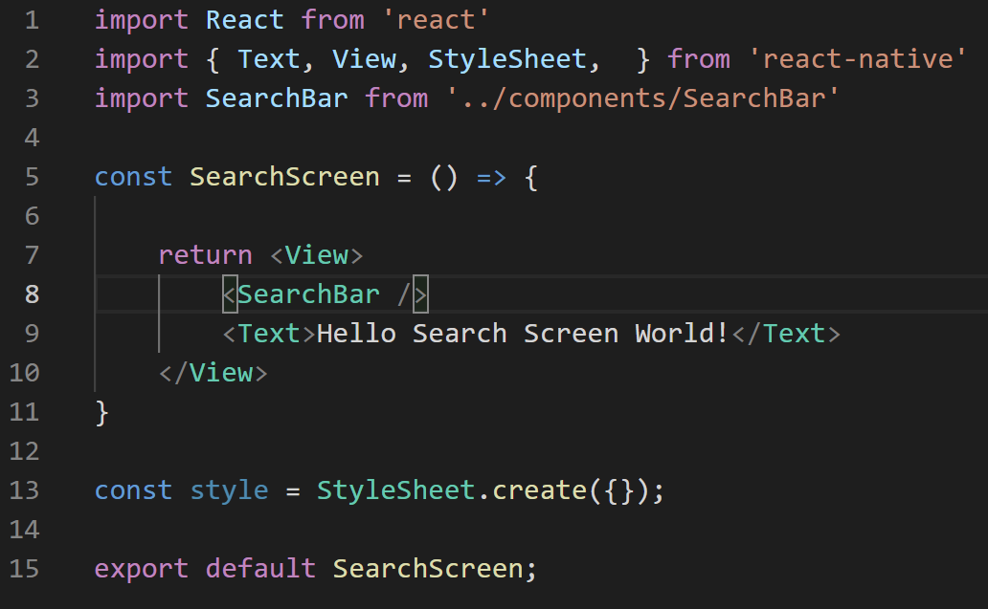
Actually Building the App
Search
And of course, to see it show up, we need to actually import the SearchBar into our main screen!
And make use of it!
SearchScreen.js

Slide 128
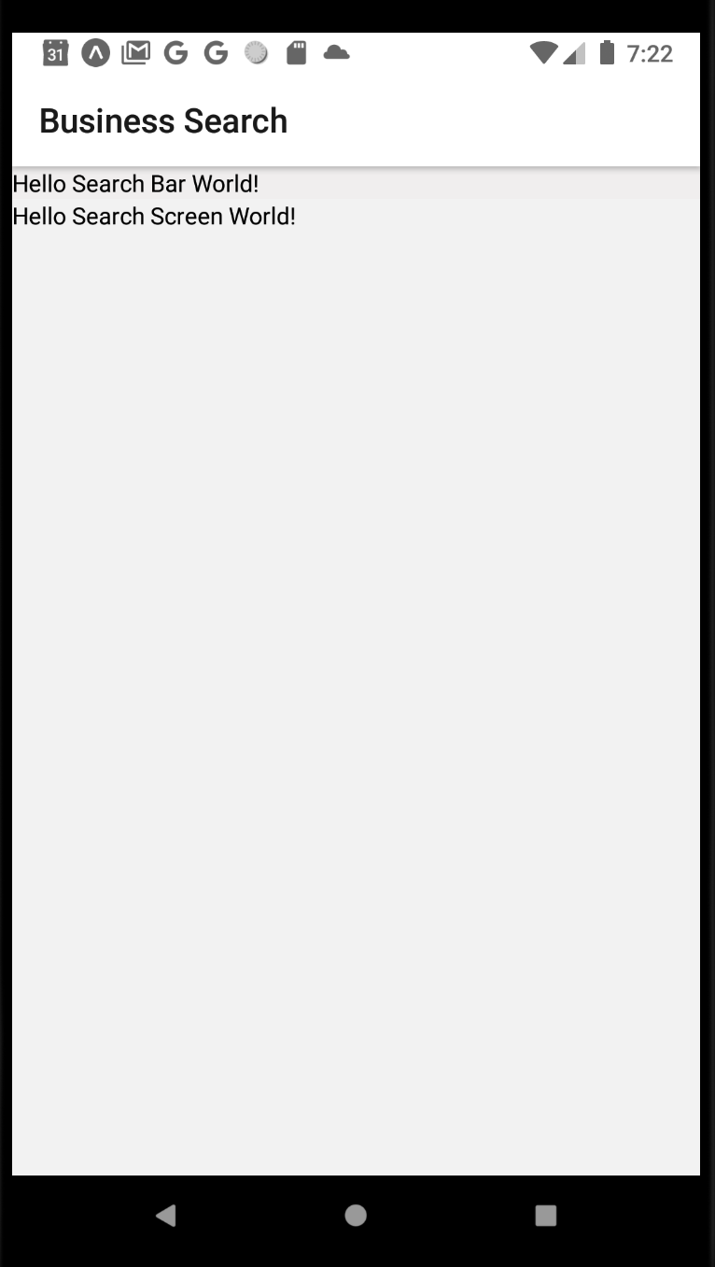
Actually Building the App
Search
They grey color that we picked is VERY light, and hard to see.
So I think I’m going to change mine to #cccccc
But you can change yours to whatever!
SearchBar.js

Slide 129
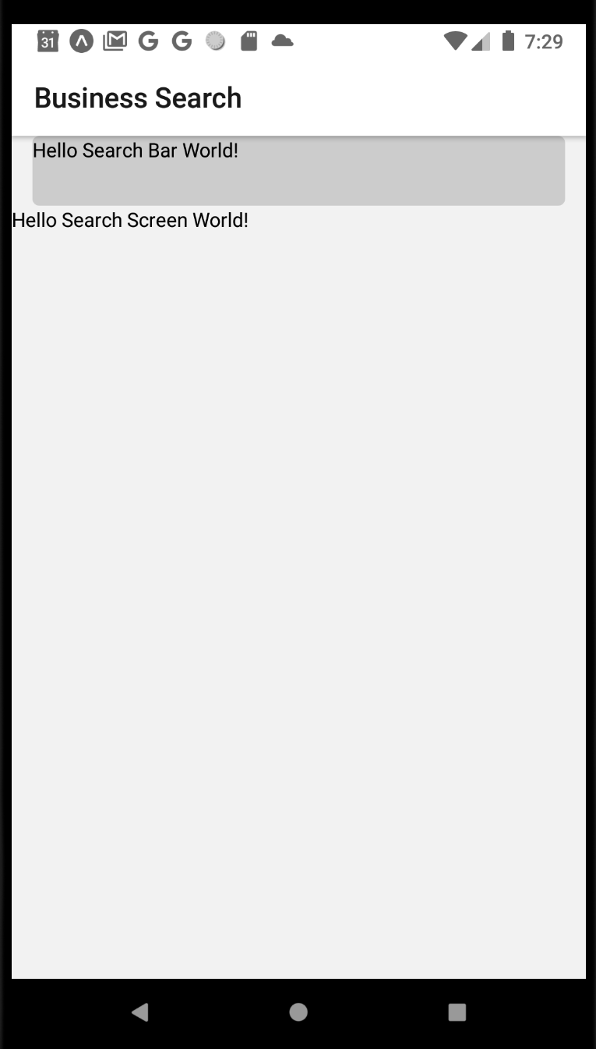

Actually Building the App
We also gave it a set height…
Some horizontal margin…
And the curved corners!
SearchBar.js

Slide 130
Actually Building the App
So great, we’re almost there already!
But what about that cool magnifying glass?
WELL – remember how when we set up the new project, we had the choice between the “barebones version” and the “expo” version (that is less barebones)?
Search

Slide 131
Actually Building the App
Because we used the expo way to set up our project, we are able to make use of those libraries and projects that are built into it for free.
One of those gifts is the “vector-icons” project.
Whose documentation can be found at:
github.com/expo/vector-icons
Search

Slide 132

Actually Building the App
But truthfully, the more exciting thing is this link:
https://oblador.github.io/react-native-vector-icons/
Which will take you to a searchable directory of all of the icons in the project!

Slide 133

Actually Building the App
Learning what to search for here is a bit of art…
For example, if we search for “magnifying” we get a couple of hits…

Slide 134

Actually Building the App
But if we instead search for “search” …
We find that several options show up!

Slide 135
Actually Building the App
And just to make sure that you’re “reading” this OK…
The name under the icon is the name of the icon itself.
Here we see two icons with the exact same name: magnifying-glass
But that big pink header is the name of the library that icon is from.
So one is from the “Entypo” library.
The other is from the “Foundation” Library.

Slide 136
Actually Building the App
So yeah – the vector-icons project has a bunch of libraries.
like Entypo and Foundation and Feather and AntDesign
And each of those libraries has a ton of icons!
So we get access to a bunch of sets of icons!

Slide 137
Actually Building the App
All we need to do to use these is remember the name of the icon, and the library that it is from.
You can pick the search icon of your dreams, but I think this “magnifying-glass” icon from Entypo looks just fine!

Slide 138

Actually Building the App
Once you’ve settled on the library, you import it, just as you’ve imported react native components!
And you could import any of those libraries we just saw, and as many of them as you would like.
SearchBar.js

Slide 139

Actually Building the App
The similarities don’t stop now!
What you are importing *is* a react native component.
And as such, you use it in the same way!
SearchBar.js

Slide 140

Actually Building the App
The way you specify the specific icon you want to use is through the use of a prop!
Specifically, the name prop, which, as you might guess, is where you specify the name of the specific icon you want!
SearchBar.js

Slide 141

Actually Building the App
And voila!
We now have an icon!
Maybe not the size we want!
Maybe not positioned correctly!
But gosh darn it, we’ve got it!

Slide 142


Actually Building the App
We can make it bigger with another prop: size
Here, we give our magnifying glass a size of 30.
And it looks much nicer!

Slide 143
Actually Building the App
We can make it bigger with another prop: size
Here, we give our magnifying glass a size of 30.
And it looks much nicer!
Or at least larger. Clearly more styling remains.

Slide 144

Actually Building the App
First, let’s convert it from a simple a Text component, into a TextInput component.
And we’ll use a new prop, placeholder, to specify the text that shows up before the user has entered anything in.
Do you remember how to get multiple things to show up horizontally, instead of vertically?
SearchBar.js

Slide 145

Actually Building the App
By setting the flexDirection property of the parent component!
So here, the parent component is the View.
And we will set the FlexDirection to ‘row’
While we’re at it, let’s add some basic styling to the TextInput as well.
SearchBar.js

Slide 146

Actually Building the App
That makes everything line up horizontally!
But there’s a couple of weirdnesses, yeah?
We can see the border of the search only fits its content
And some of the text along the left hand side gets cut off.

Slide 147


Actually Building the App
Thankfully it is an easy fix.
Remember: you can set the ‘flex’ property of a component, which will make it try to use up all available space within the parent.
And then it looks just fine!

Slide 148

Actually Building the App
Now, there’s still some styling issues with the icon…
So, let’s just bite the bullet and give it its own style object.

Slide 149
Actually Building the App
Note that we NO LONGER specify its size inline here!
Instead, we specify the fontSize property in its style object, which has the same effect as the prop of size.
That’s just how you do it!

Slide 150

Actually Building the App
There’s plenty of other changes we can make that we’ve seen before.
marginTop on the View – make it not butt up against the top of the screen.
removing the borderColor and borderWidth of the inputStyle
They are good for debugging, but you don’t always want them in “real life”
alignSelf on the iconStyle
Giving it center makes it vertically centered.
marginHorizontal on the iconStyle
Give it some space to its left and right.

Slide 151

Actually Building the App
And now we’re left with this!
Which if you don’t mind me saying, is actually looking pretty darn good!
Kinda looks like a real life search bar, eh?

Slide 152
Actually Building the App
SO! GREAT! It is officially STYLED!
But what was the other big thing we talked about with TextInput components?
It was: even though they are capable of managing their own state and the screen re-renders just fine…
We typically want to store the state in the PARENT component.
So that whatever is input into the InputText can then be distributed to the other components of the app.

Slide 153
Actually Building the App
SearchScreen
searchTerm
Same thing here!
We’ll want to define some piece of state inside of the SearchScreen that will represent the contents of the SearchBar
We can call that state searchTerm for now.
We’ll pass both that state, AND the setter function that the useState hook gives us down to SearchBar.
searchTerm
onSearchTermChange
SearchBar

Slide 154
Actually Building the App
SearchScreen
searchTerm
This way, when the user types something into SearchBar, we can call the setter to update the contents of the state…
But also, searchTerm now lives inside of searchScreen (the parent component), and so it can be used in other parts of our app!
Such as being passed over to Yelp to grab data from them!
searchTerm
onSearchTermChange
SearchBar

Slide 155
Actually Building the App
SearchScreen
searchTerm
We’ve basically done this already!
This is review!
The difference is that last time, there wasn’t a “reusable component” in the mix – our TextInput was just in our Screen file.
But essentially nothing changes here!
searchTerm
onSearchTermChange
SearchBar

Slide 156

Actually Building the App
SearchScreen.js
We import and use the useState hook!
And then we pass both the read-only piece of state, as well as a callback function that will ultimately invoke the setter for that state, down to our SearchBar component via props.

Slide 157

Actually Building the App
SearchBar.js
And then to access those props in the child component, don’t forget we add the props parameter here.
And then we provide searchTerm to the value prop.
Remember: value specified what should be displayed in the TextInput
And we provide our callback function to onChangeText
Remember: it itself is expecting a function, which takes in a parameter (here called ‘newTerm’) that stores whatever the current value of the TextInput is.

Slide 158
Actually Building the App
SearchBar.js
And remember: the props.onTermChange *is* a function itself.
So onChangeText is a function…
…whose parameter is the ‘new value’ of the TextInput…
…and whose body is a call to props.onTermChange
Which itself is just a call to the setter function for our state.
In short: every time the text is changed, call our setter to update our state.

Slide 159

Actually Building the App
SearchScreen.js
An easy way to test if it is working is to print out the value of searchTerm in the parent component.
Hopefully, as you edit it in the child component, those updates should be reflected here!

Slide 160

Actually Building the App
And indeed, it looks pretty good!
Also kind of looks like our phone is having a stroke.
But the point remains! We’re successfully updating state that is stored in a parent component but is modified in a child component.

Slide 161

Actually Building the App
The last thing, which as said before, is just generally a good habit to get into with TextInput components…
Turn autoCorrect to false.
turn autoCapitalize to ‘none’
More stuff we’ve seen before!

Slide 162
Actually Building the App
OK – a lot of that was a refresher on stuff we’ve done already!
But there’s one more thing that we want.
We probably don’t want to initiate a new search every single time they enter a character…
We probably want to detect when they are “done”
They hit “enter”
They press the “checkmark”
etc.

Slide 163

Actually Building the App
Thankfully, there’s another prop for that on TextInput.
The name of the prop is onEndEditing
It takes in a callback function as input.
And it will call that function whenever the user signifies that they are done typing!

Slide 164

Actually Building the App
Thankfully, there’s another prop for that on TextInput.
The name of the prop is onEndEditing
It takes in a callback function as input.
And it will call that function whenever the user signifies that they are done typing!

Slide 165

Actually Building the App
SearchScreen.js
Of course, nothing is ever quite that simple!
Yes, SearchBar is where the TextInput is…
But it’s our SearchScreen that is going to actually call Yelp.
SO… we need to pass down *another* callback function!
Note here in searchScreen, we’ve added another prop, which has that callback function!

Slide 166

Actually Building the App
SearchBar.js
And then we change onEndEditing to then invoke that passed in function.

Slide 167
Actually Building the App
OK, phew, that was a lot!
Some new, some review!
We still have a ways to go…
But we can do it! We can get there!
We will chat about using the Yelp API next time!

